Slide 1
Continuous Integration
Prof. Hsi-Min Chen
Dept. of Information Engineering and Computer Science
Feng Chia University

Slide 2
Outline
DevOps and Continuous Integration
Unit Test - JUnit
Build Automation - Maven
Version Control – Git and GitHub
Continuous Integration Server - Jenkins

Slide 3
DevOps and Continuous Integration

Slide 4
Software Crisis
Projects running over-budget
Projects running over-time
Software was very inefficient
Software was of low quality
Software often did not meet requirements
Projects were unmanageable and code difficult to maintain
Software was never delivered

Slide 5
Software Engineering
a systematic approach to designing, developing, testing, and maintaining software systems
Importance of Software Engineering
Ensures high-quality, reliable, and efficient software development.
Manages complexity in large-scale projects.
Facilitates collaboration among multidisciplinary teams.

Slide 6
Software Development Life Cycle (SDLC)
Waterfall Model: Sequential phases (Requirements, Design, Implementation, Testing, Deployment, Maintenance).
Agile Methodology: Iterative and incremental development, emphasizing flexibility and customer collaboration.

Slide 7
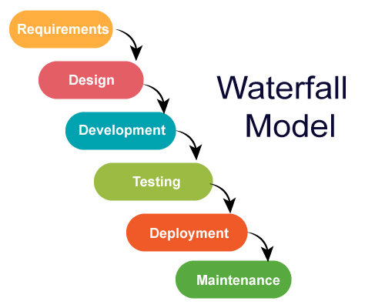
Waterfall Model
a linear and sequential approach to software development, where progress flows steadily downwards through defined phases
Phases of the Waterfall Model
Requirements Gathering: Initial phase where client requirements are collected and documented.
System Design: System architecture is defined based on the gathered requirements.
Implementation: The system is developed based on the design specifications.
Testing: Rigorous testing is performed to identify and fix defects.
Deployment: The finalized system is deployed to the production environment.
Maintenance: Ongoing support, bug fixes, and updates are provided.

Slide 8
Waterfall Model
Advantages
Clear Milestones: Well-defined phases provide clear milestones for progress tracking.
Documentation: Extensive documentation is produced at each phase, aiding in maintenance and future development.
Suitable for Stable Projects: Effective for projects with well-understood and unchanging requirements.
Disadvantages
Inflexibility: difficult to accommodate changes once the project has started.
Late Feedback: Client involvement mainly at the beginning and end can lead to misunderstandings.
Long Delivery Time: may result in longer time-to-market compared to Agile methodologies.
Notes:
Use Cases
Regulated Industries: Common in industries with strict compliance and documentation requirements (e.g., healthcare, aerospace).
Small Projects with Well-Defined Requirements: When the scope and requirements are clear and stable.

Slide 9
Agile Methodology
an iterative and incremental approach to software development that emphasizes flexibility, collaboration, and customer satisfaction
Core Values of Agile
Individuals and Interactions: Valuing people and their interactions over processes and tools.
Working Software: Prioritizing a functional product as the primary measure of progress.
Customer Collaboration: Actively involving customers and stakeholders throughout the development process.
Responding to Change: Embracing change to adapt to evolving requirements.

Slide 10
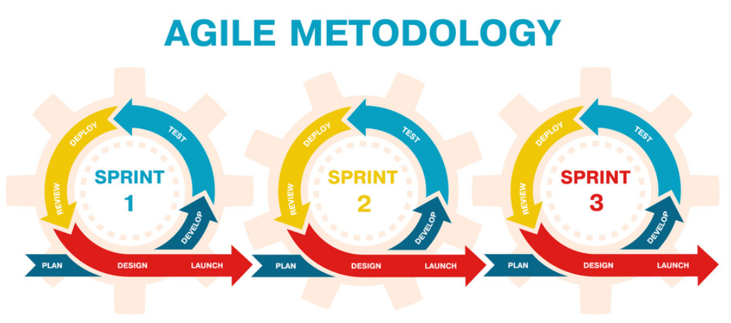

Slide 11
Agile Methodology
Benefits of Agile
Flexibility: Ability to adapt to changing requirements and priorities.
Customer-Centric: Involves the customer throughout the development process
Faster Time-to-Market: Frequent releases lead to quicker delivery of value
Use Cases
Dynamic Requirements: Ideal for projects with evolving or unclear requirements
Cross-Functional Teams: Effective in multidisciplinary teams with close collaboration

Slide 12
Agile Methodology

Slide 13
Extreme Programming
Practices of Extreme Programming
Coding Standards
Collective Ownership
Continuous Integration
On-Site Customer
Pair Programming
Planning Game
Refactoring
Short Releases
Simple Design
Sustainable Pace (40 Hour Week)
System Metaphor
Test-Driven Development

Slide 14
DevOps
is a set of practices that combines software development (Dev) and IT operations (Ops) to shorten the software development lifecycle while delivering features, fixes, and updates frequently and reliably

Slide 15
DevOps
Core Principles of DevOps
Collaboration: Fosters a culture of collaboration between development and operations teams.
Automation: Utilizes automation to streamline and accelerate the software delivery process.
Continuous Integration (CI): Integration of code changes into a shared repository frequently.
Continuous Deployment (CD): Automatically deploys code changes to production after passing automated tests.
Monitoring and Feedback: Provides continuous monitoring and feedback on application performance and user experience.

Slide 16
DevOps
Benefits of DevOps
Faster Time-to-Market: Shortens development cycles, allowing quicker delivery of new features.
Improved Quality: Automation reduces the chance of human error and improves software reliability.
Increased Collaboration: Encourages cross-team collaboration and communication.
Efficient Resource Utilization: Optimizes resource usage through automation and efficient workflows.

Slide 17
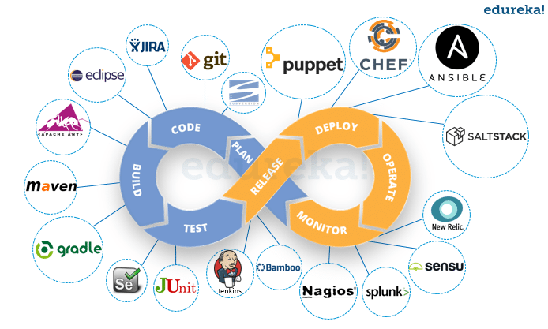
DevOps
DevOps Tools and Technologies

Slide 18
Continuous Integration
Continuous Integration (CI) is a development practice that encourages developers to frequently integrate their code changes into a shared repository
Each integration is verified by an automated build and automated tests

Slide 19
Continuous Integration
Core Principles of Continuous Integration
Frequent Code Integration: Developers integrate code changes multiple times a day
Automated Build and Test: Code is automatically built and tested upon integration
Immediate Feedback: Developers receive immediate feedback on the status of their code changes
Maintain a Stable Mainline: The main branch should always be deployable

Slide 20
Continuous Integration
Benefits of Continuous Integration
Reduced Integration Issues: Early and frequent integration helps catch and resolve issues quickly
Higher Code Quality: Automated tests ensure code meets quality standards.
Faster Development Cycles: Rapid integration and feedback accelerates the development process
Improved Collaboration: Encourages a collaborative environment and fosters team ownership

Slide 21
Continuous Integration

Slide 22

Continuous Integration and Testing

Slide 23
Unit Test - JUnit

Slide 24
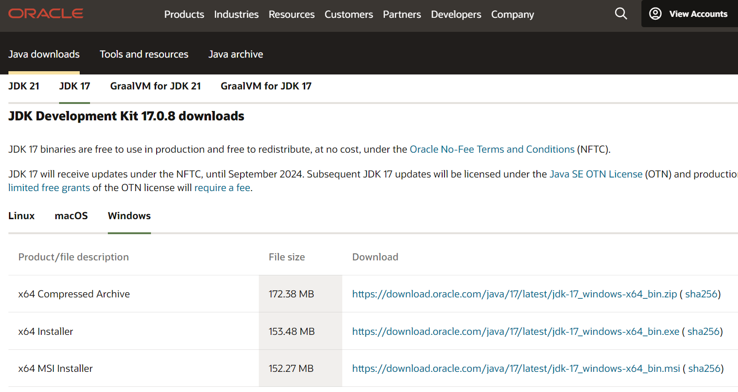
IDE for Java programming - IntelliJ
Download and install JDK
https://www.oracle.com/java/technologies/downloads/#java17

Slide 25
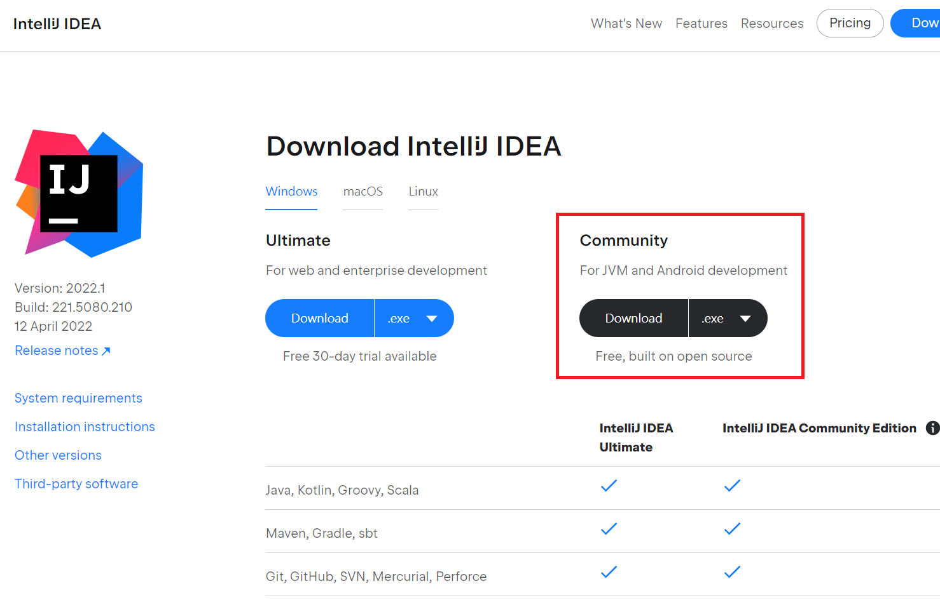
IDE for Java programming - IntelliJ
Download and install IntelliJ
https://www.jetbrains.com/idea/download/#section=windows

Slide 26
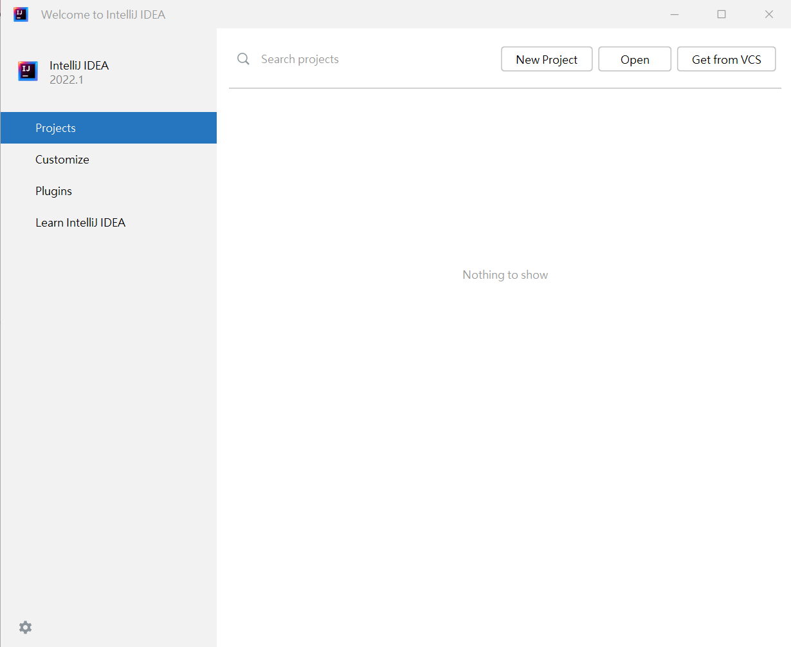
Create Project

Slide 27
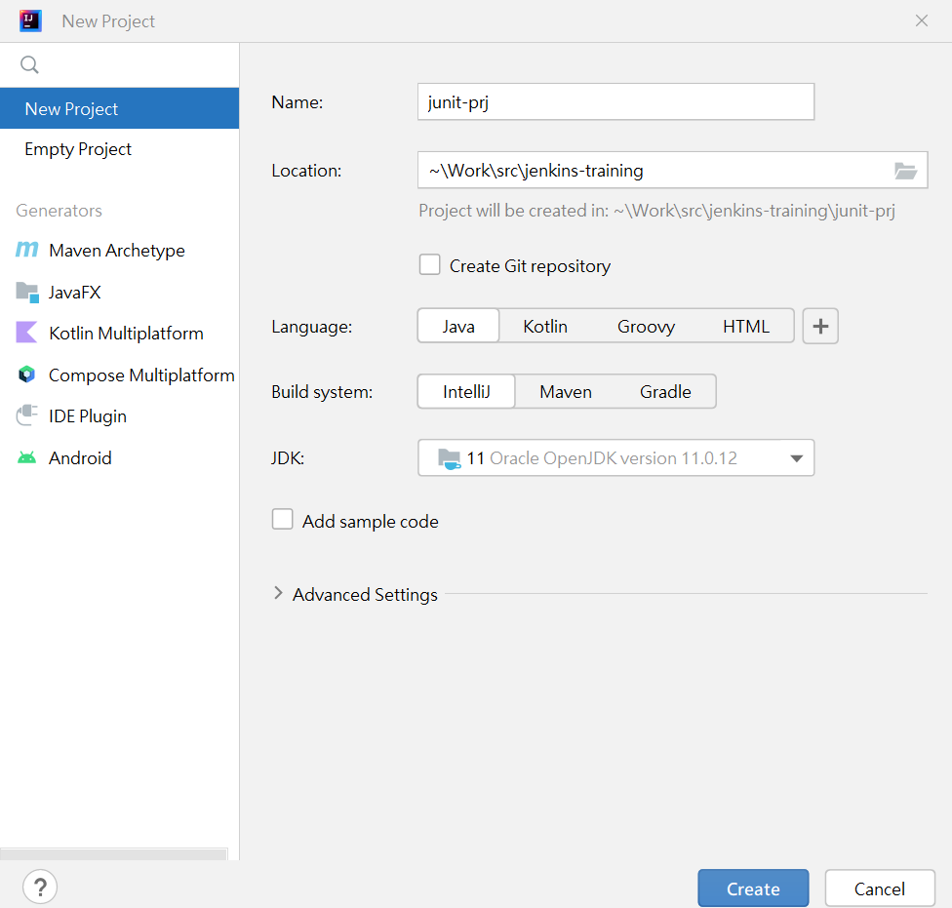
Create Project

Slide 28
Create Project

Slide 29
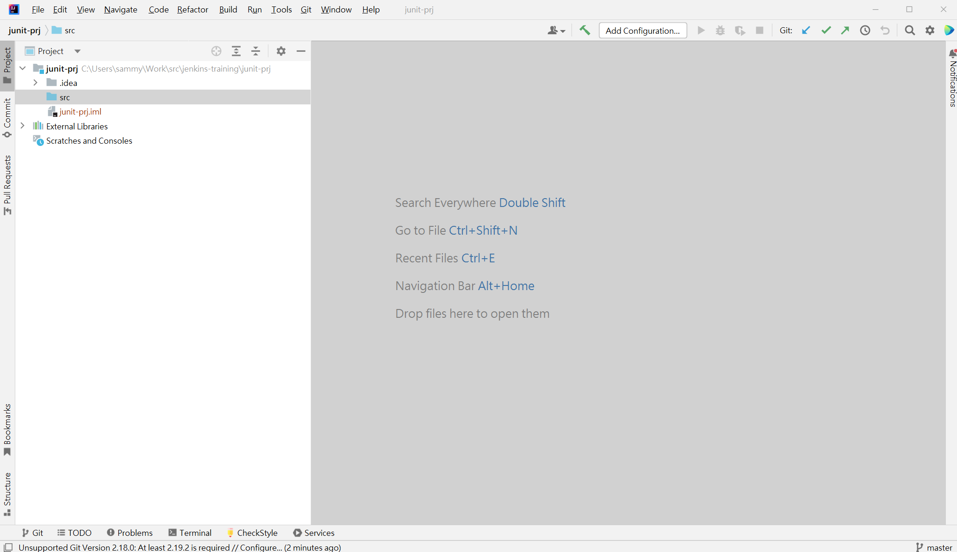
Create Project

Slide 30
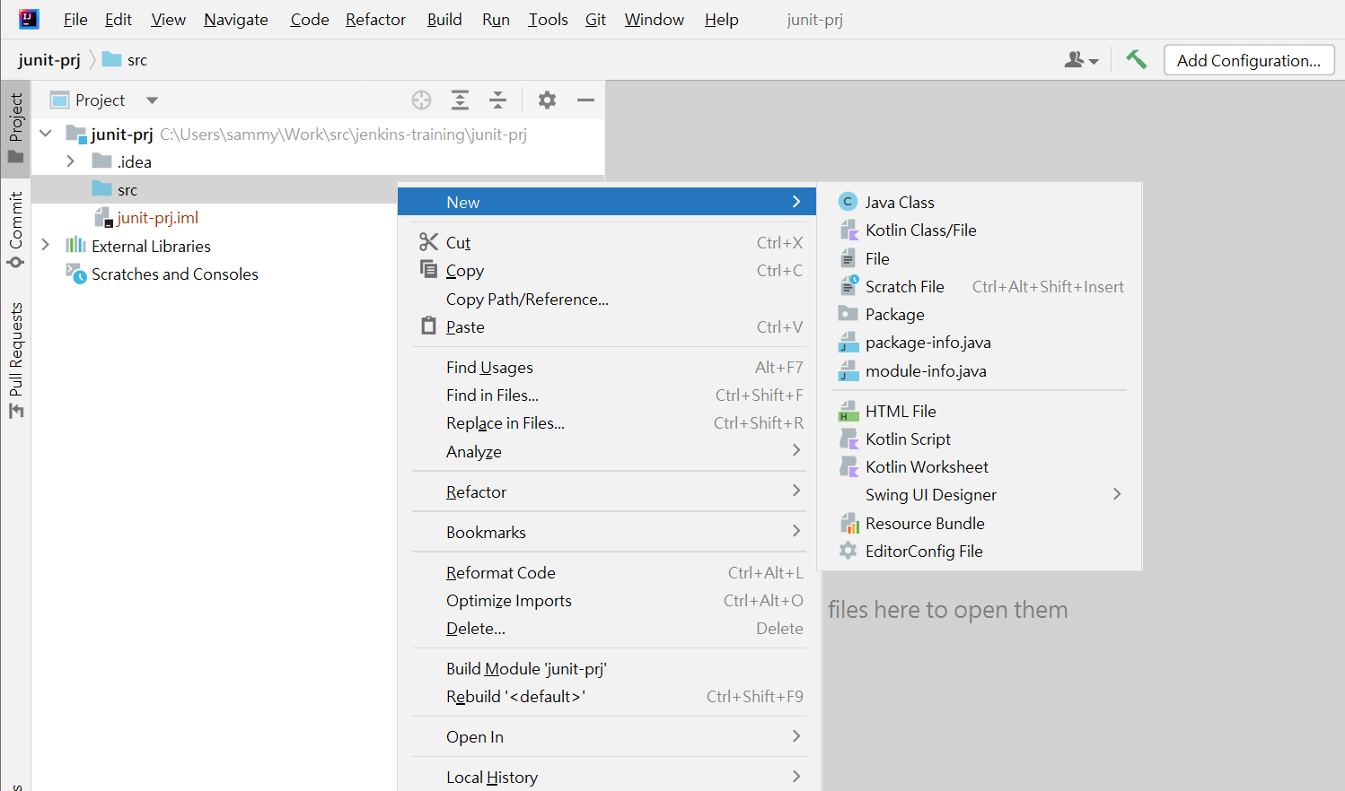
Create Class

Slide 31
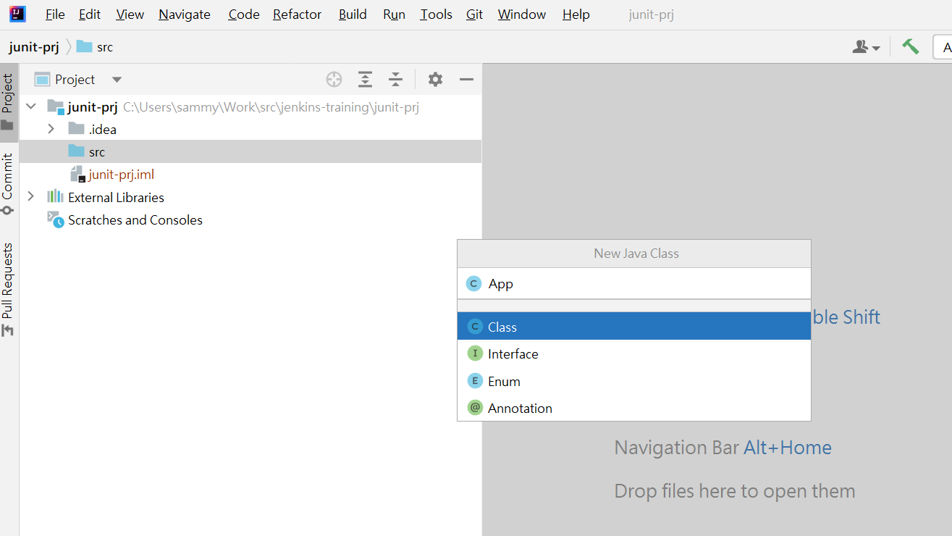
Create Class

Slide 32
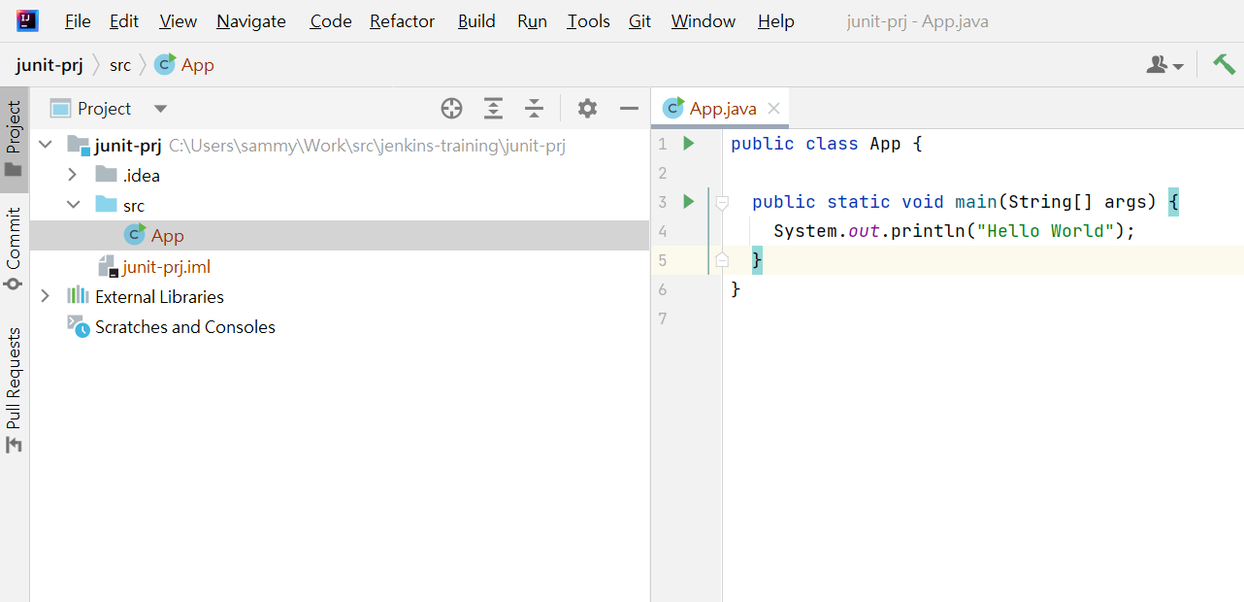
Create Class

Slide 33
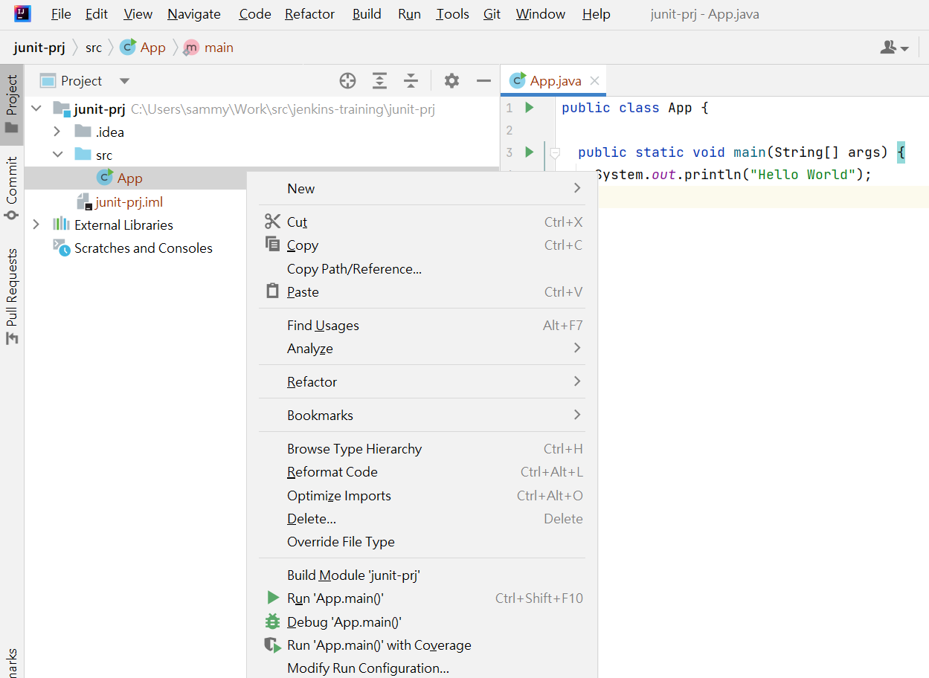
Execute the Program

Slide 34
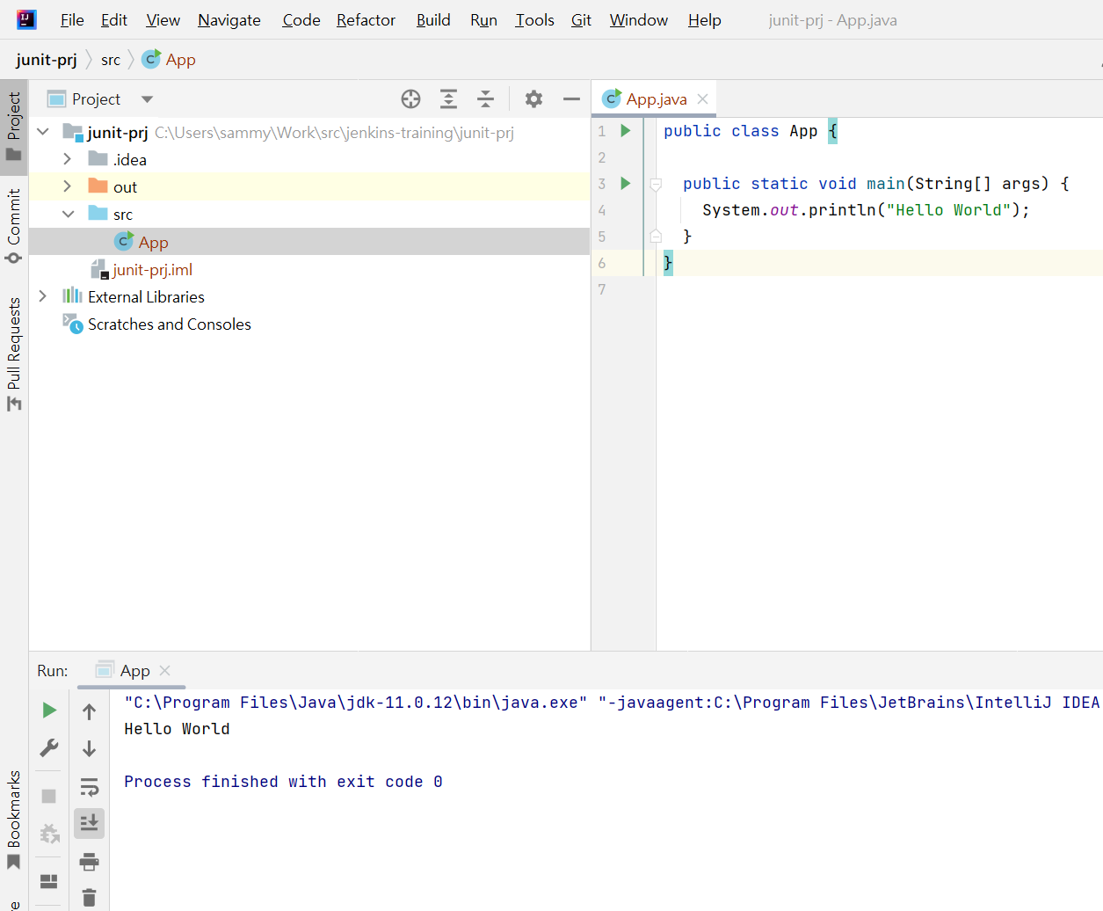
Check Execution Result

Slide 35
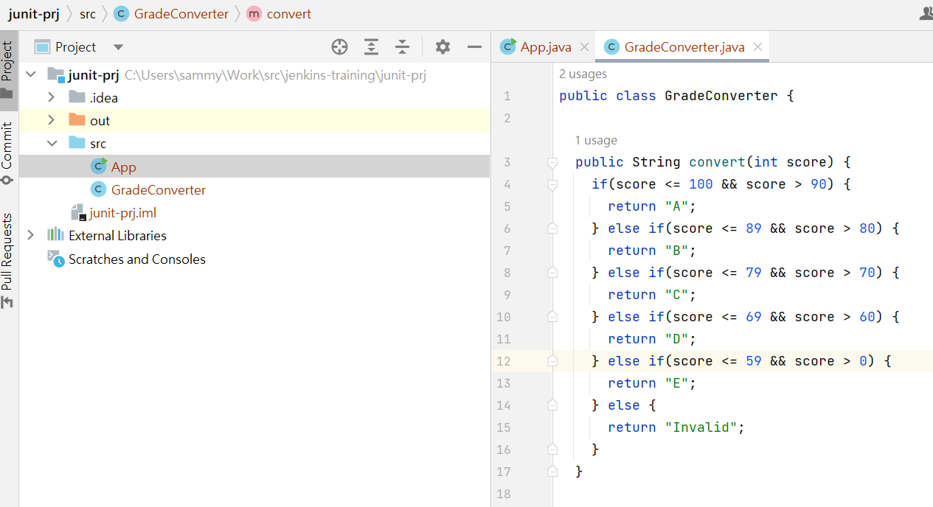
The Program under Test

Slide 36
The Program under Test
public class GradeConverter { public String convert(int score) { if(score <= 100 && score > 90) { return "A"; } else if(score <= 89 && score > 80) { return "B"; } else if(score <= 79 && score > 70) { return "C"; } else if(score <= 69 && score > 60) { return "D"; } else if(score <= 59 && score > 0) { return "E"; } else { return "Invalid"; } }

Slide 37
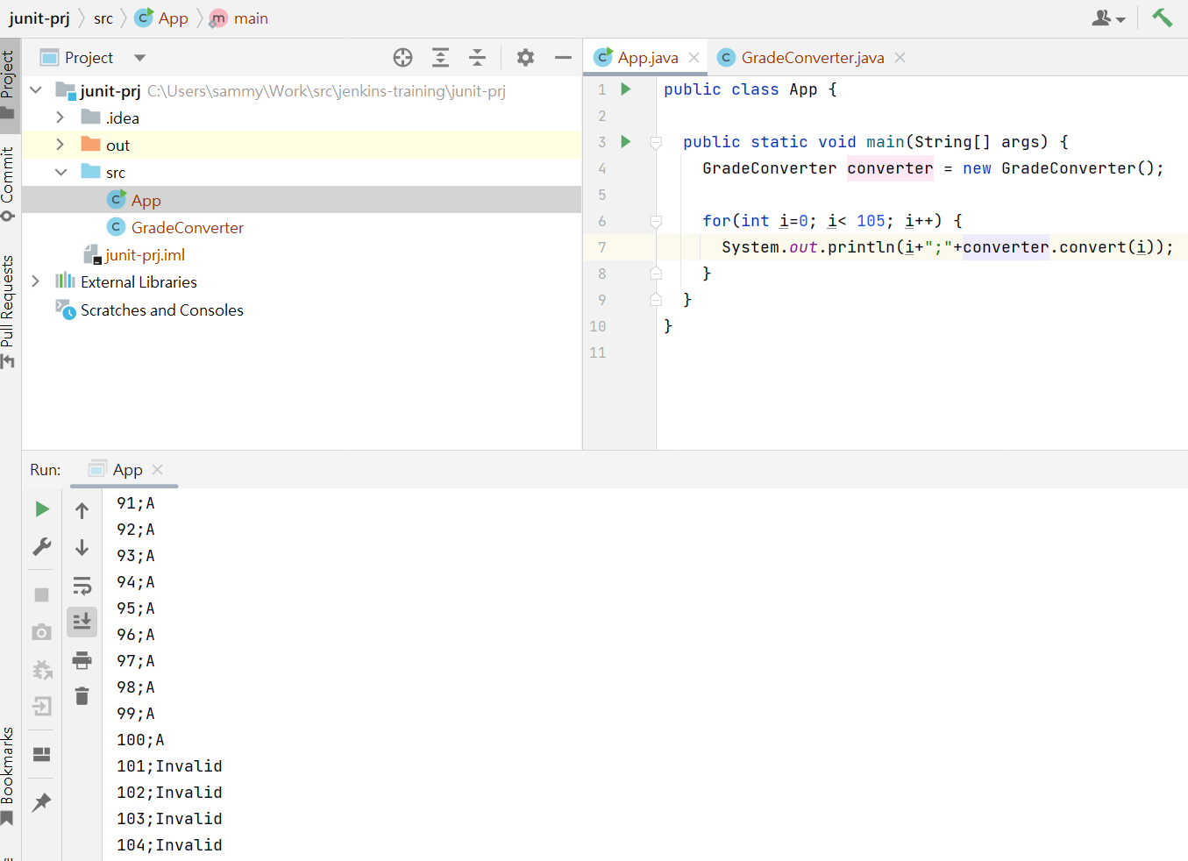
Manual Test

Slide 38
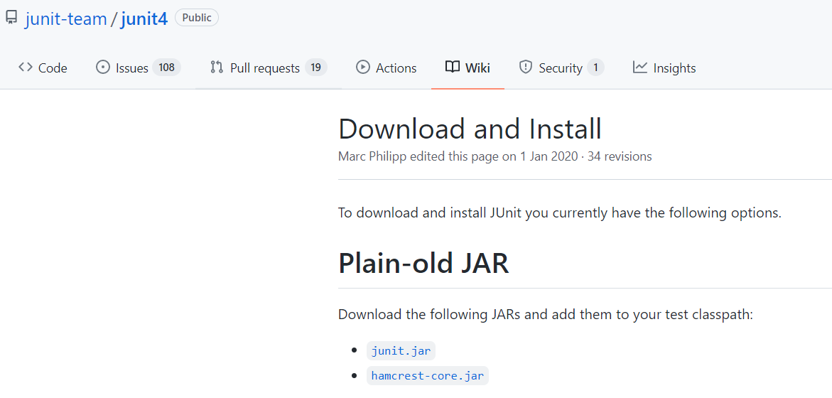
JUnit Library
Download JUnit Library
https://github.com/junit-team/junit4/wiki/Download-and-Install

Slide 39
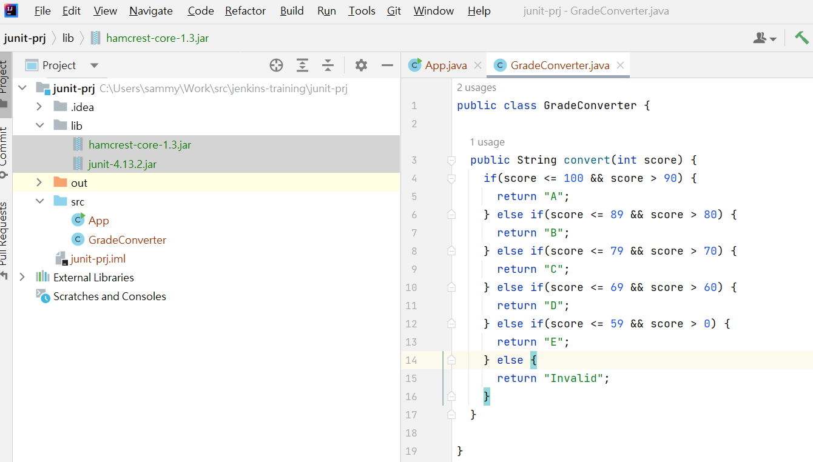
Install JUnit Library

Slide 40
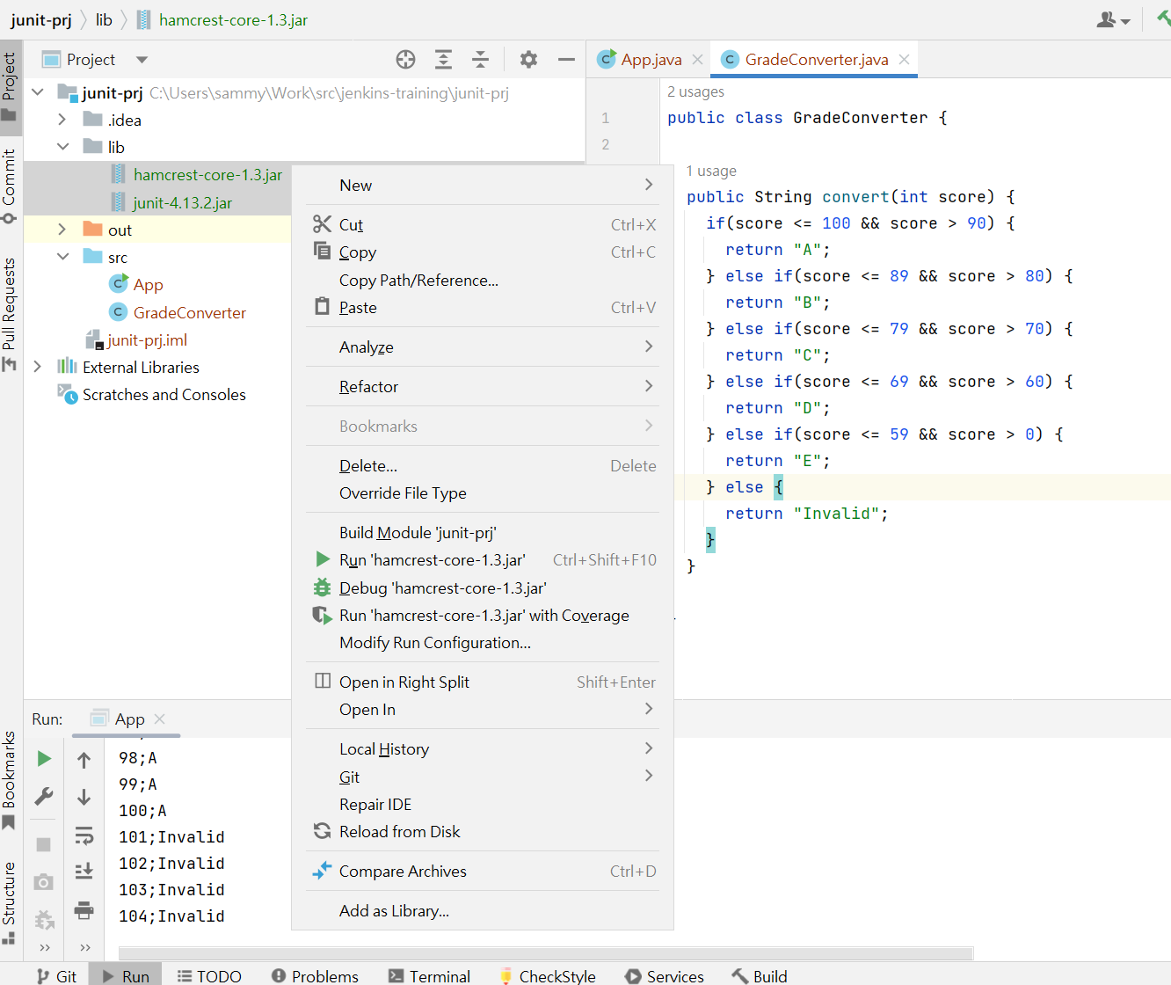
Install JUnit Library

Slide 41
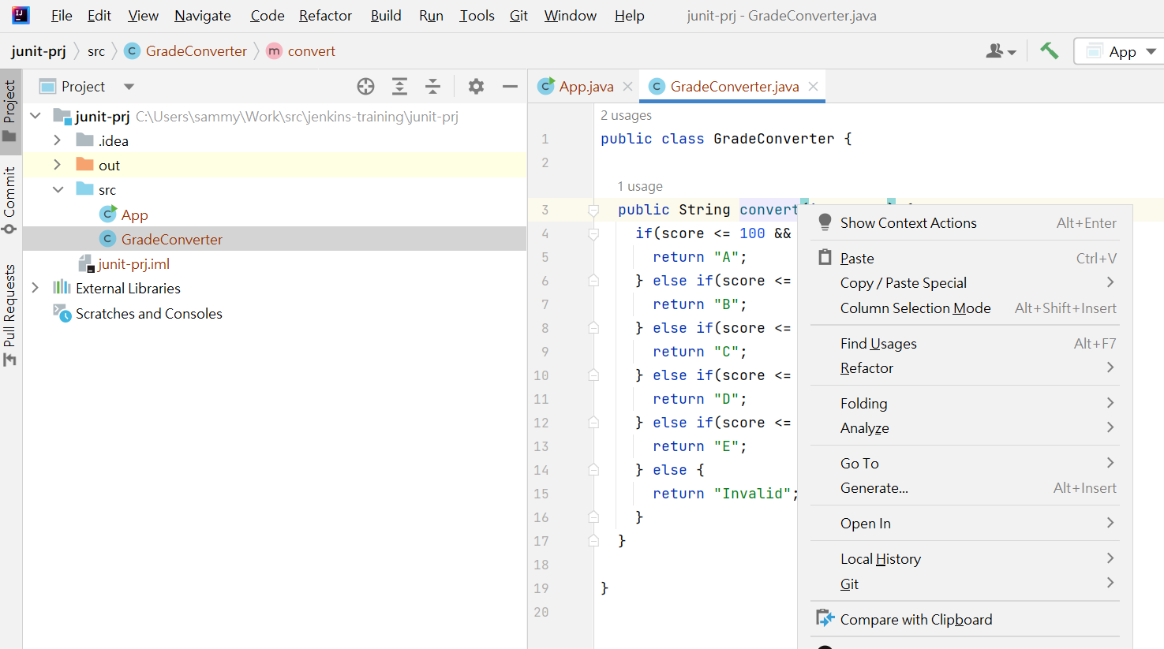
JUnit – Generate Test Case

Slide 42
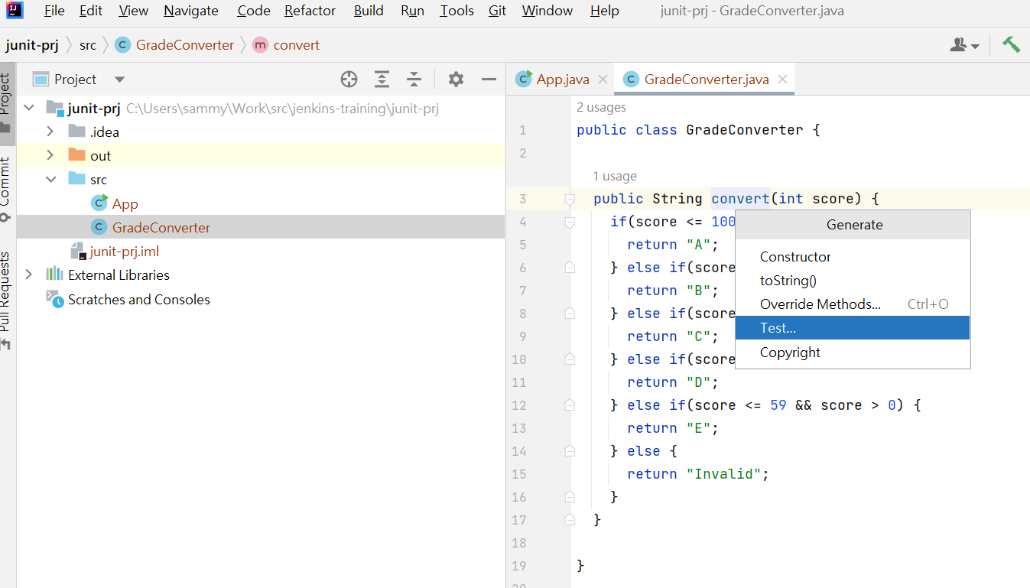
JUnit – Generate Test Case

Slide 43
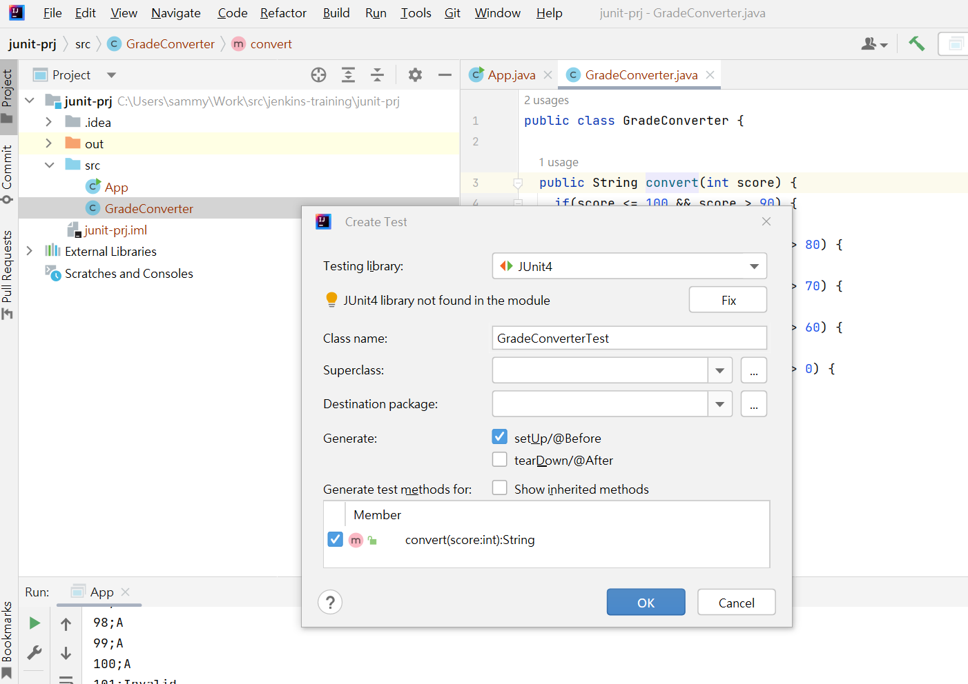
JUnit – Generate Test Case

Slide 44
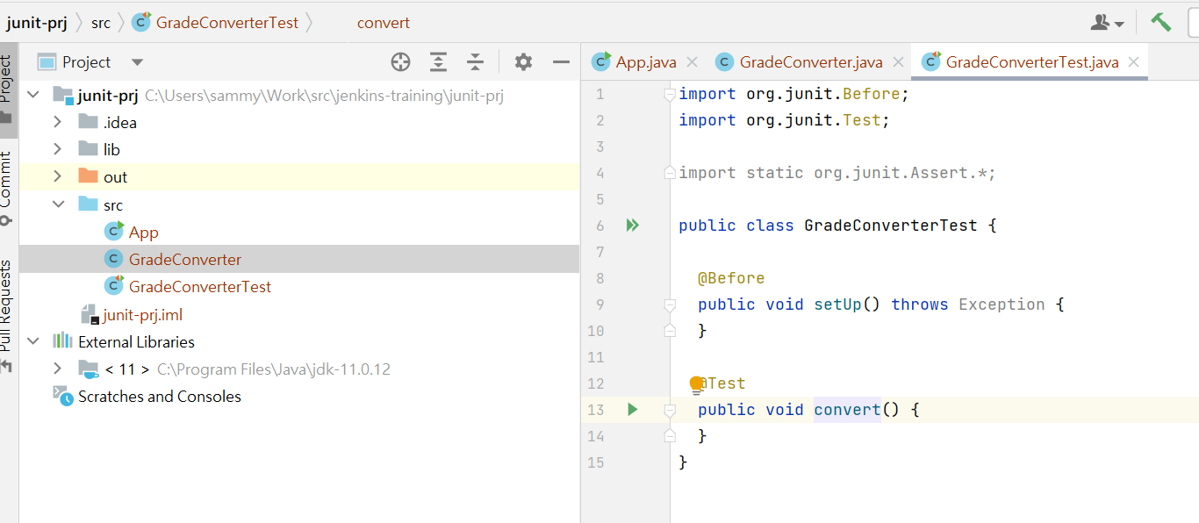
JUnit – Generate Test Case

Slide 45
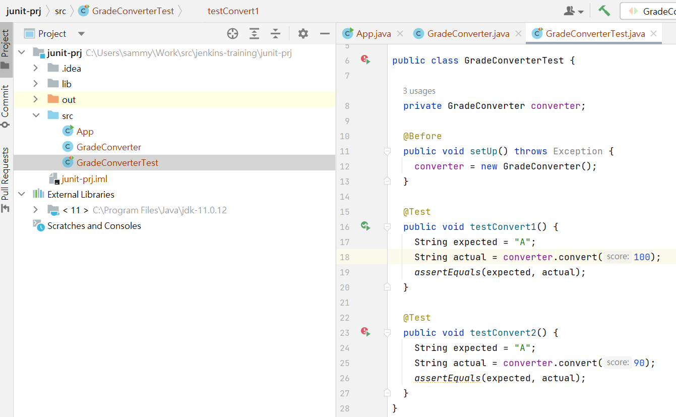
JUnit – Generate Test Case

Slide 46
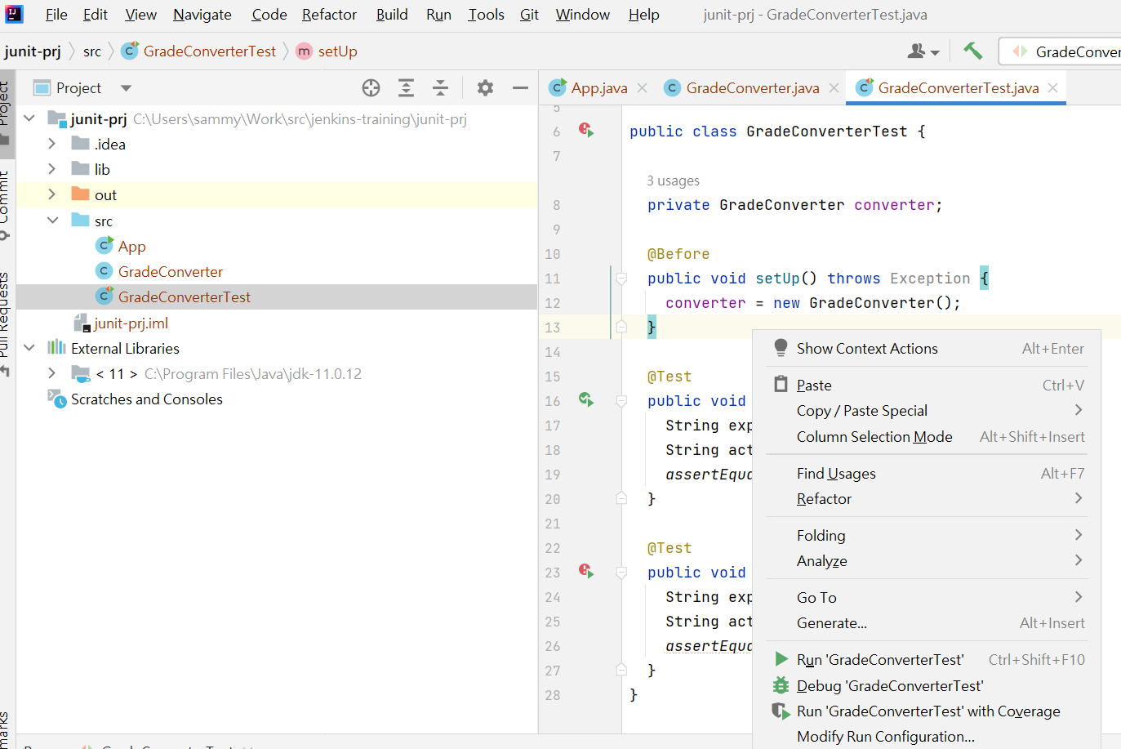
JUnit – Run Test Case

Slide 47
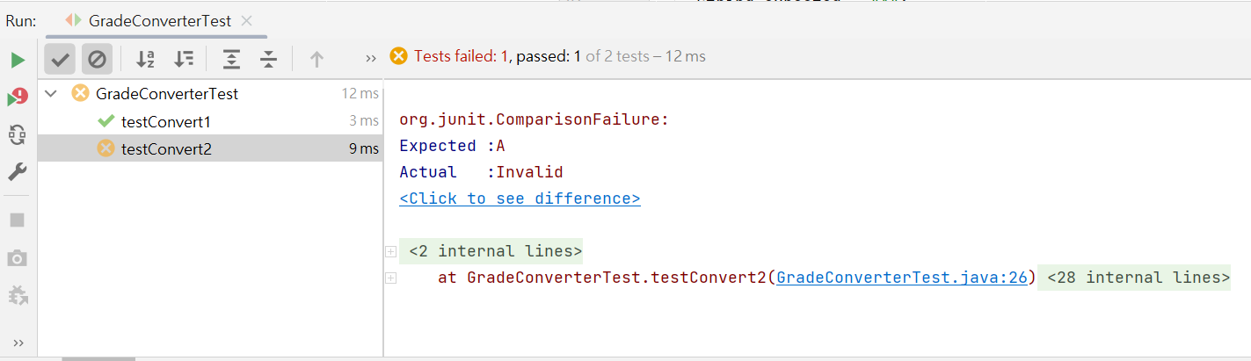
JUnit – Check Test Result

Slide 48
Build Automation - Maven

Slide 49
What is Apache Maven?
Maven is a powerful build automation and project management tool that simplifies the build process, handles dependencies, and provides a uniform project structure.
Key Features of Maven
Dependency Management: Manages project dependencies and ensures consistent builds.
Build Lifecycle: Defines a series of phases for building, testing, and packaging projects.
Project Object Model (POM): An XML file that contains project information and configuration details.
Plugins: Extensible architecture allowing the addition of custom functionality.

Slide 50
Maven Build Lifecycle
Maven Build Lifecycle
Clean: Removes target directory to start with a clean slate.
Validate: Validates project structure and dependencies.
Compile: Compiles source code into bytecode.
Test: Executes tests using a suitable unit testing framework.
Package: Takes compiled code and packages it into a distributable format (e.g., JAR, WAR).
Install: Installs the package into the local repository.
Deploy: Copies the final package to a remote repository.

Slide 51
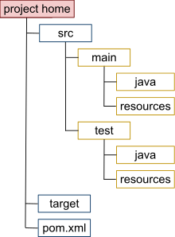
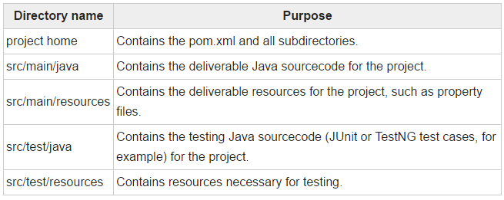
Project Structure in Maven

Slide 52
POM (Project Object Model)₁
The Project Object Model (POM) is an XML file in Maven that contains information about the project and configuration details needed for building the project.
Components of POM
Group ID: Unique identifier for a group of related artifacts.
Artifact ID: Unique identifier for a specific artifact within a group.
Version: Identifies the version of the artifact.
Packaging: Specifies the type of artifact (e.g., JAR, WAR).
Dependencies: Lists external libraries required for the project.
Build Configuration: Specifies build settings and plugins.
Repositories: Defines where to find project dependencies.

Slide 53
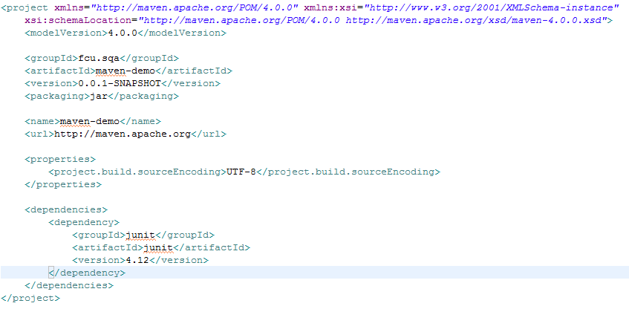
POM (Project Object Model)₂

Slide 54
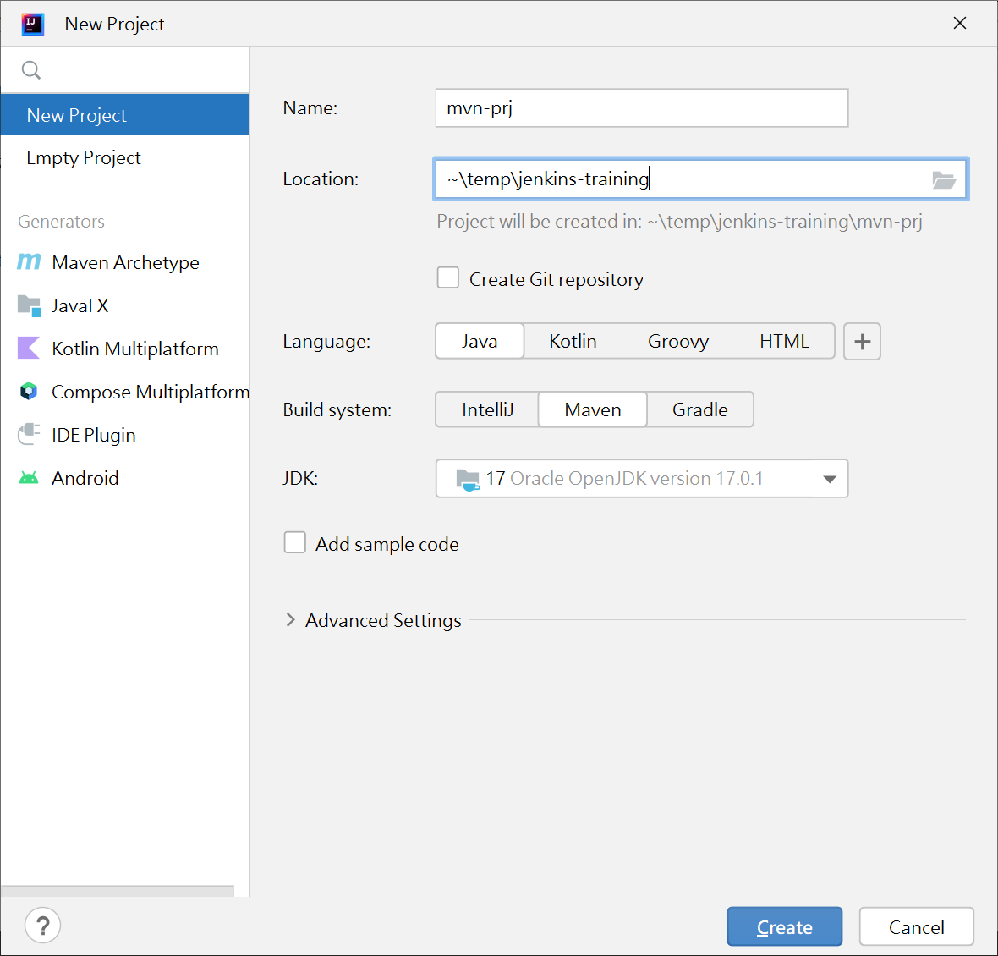
Maven in IntelliJ

Slide 55
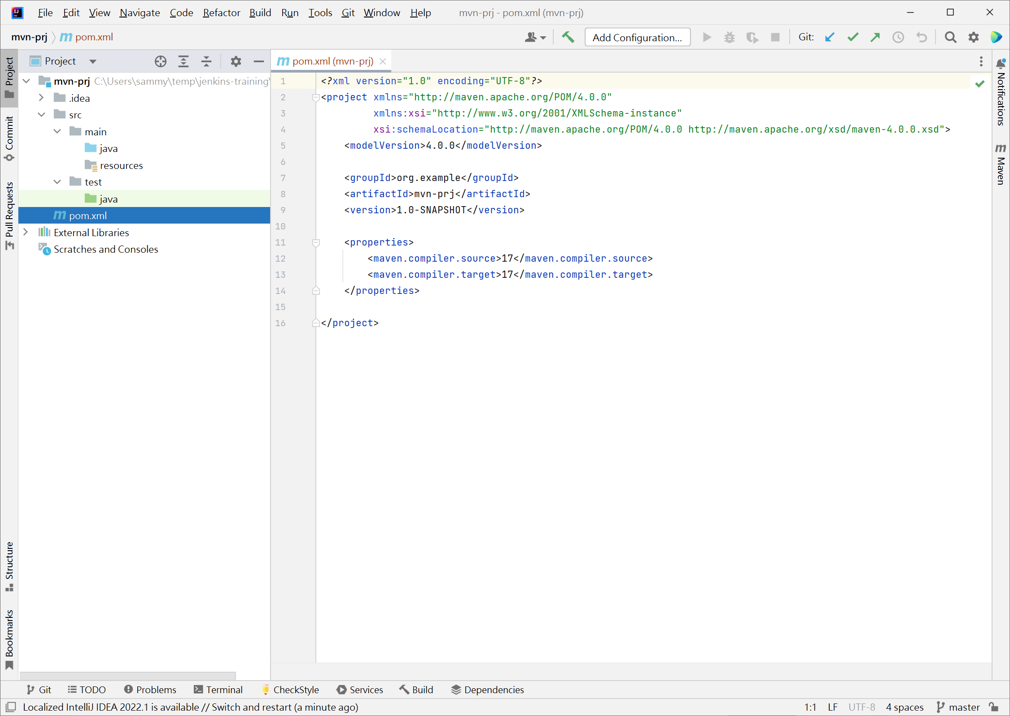
Configuration in POM

Slide 56
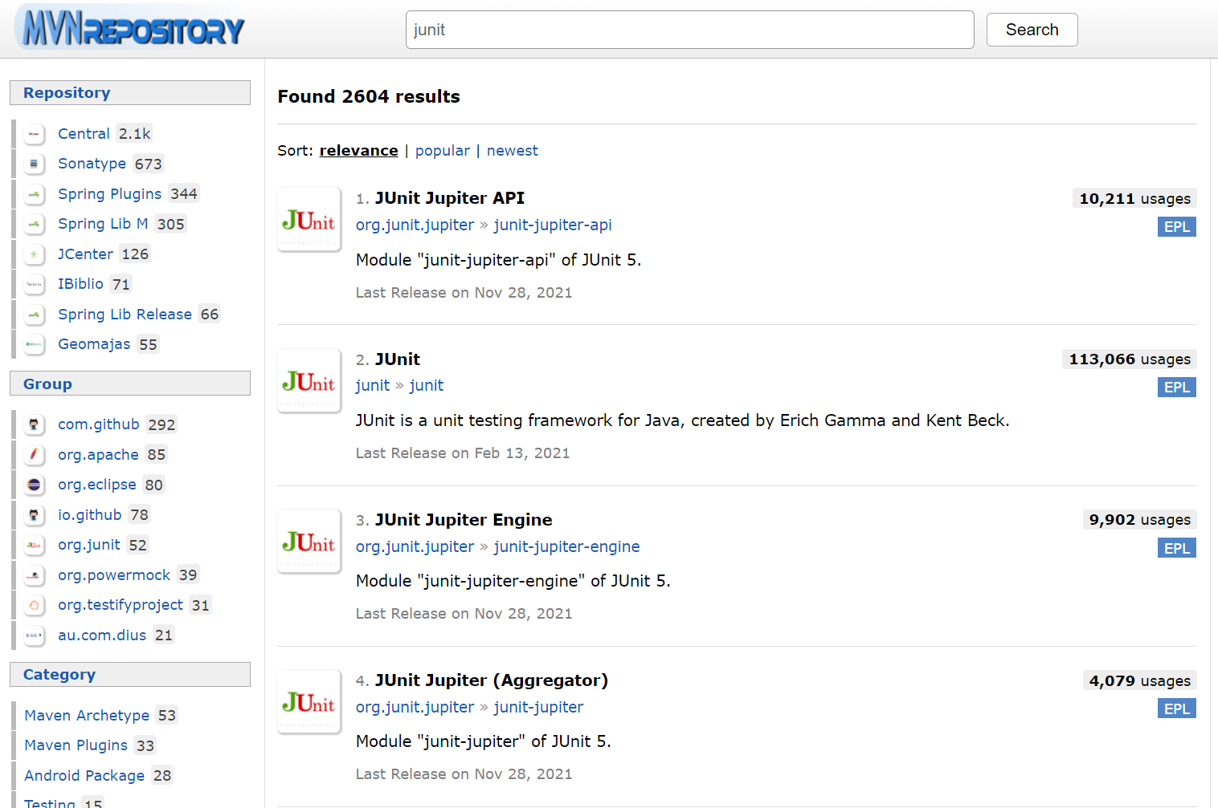
Maven repository https://mvnrepository.com/

Slide 57
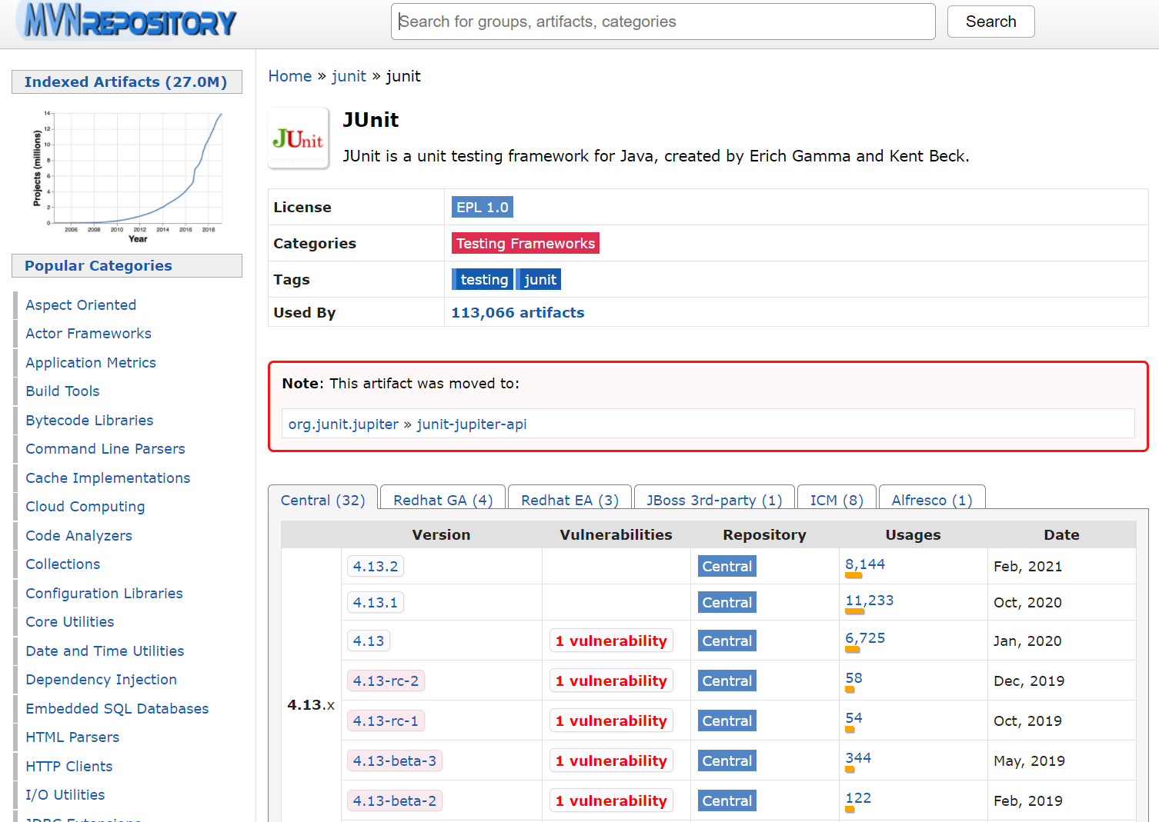
Maven repository https://mvnrepository.com/

Slide 58
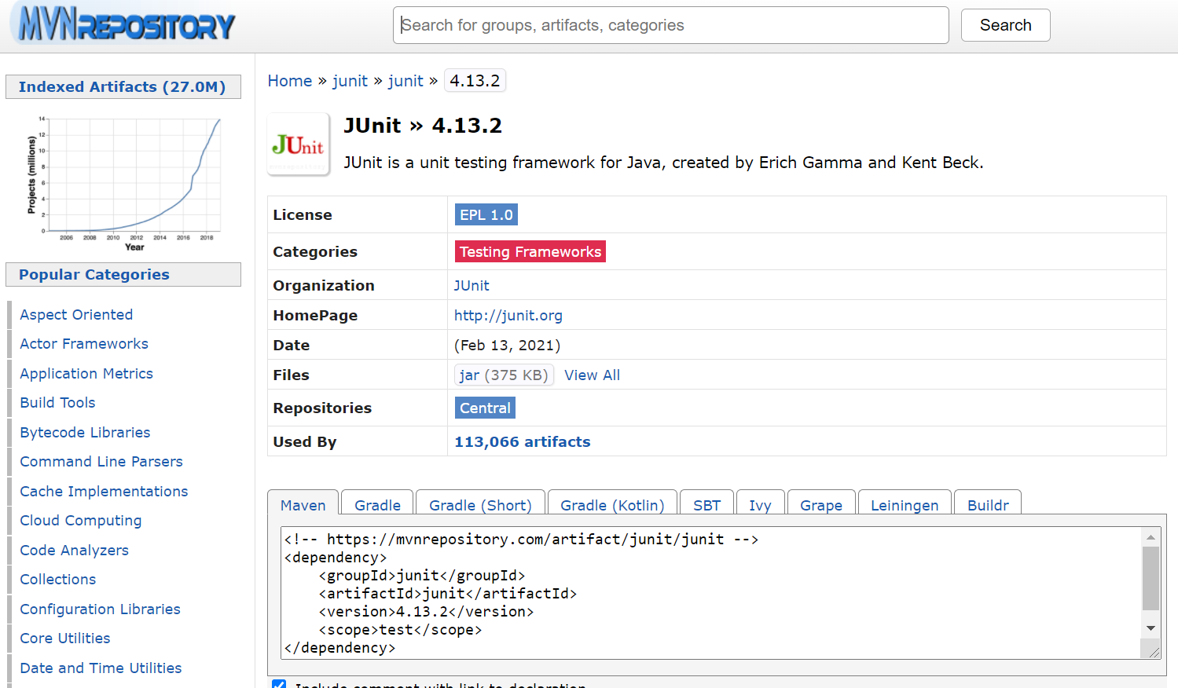
Maven repository https://mvnrepository.com/

Slide 59
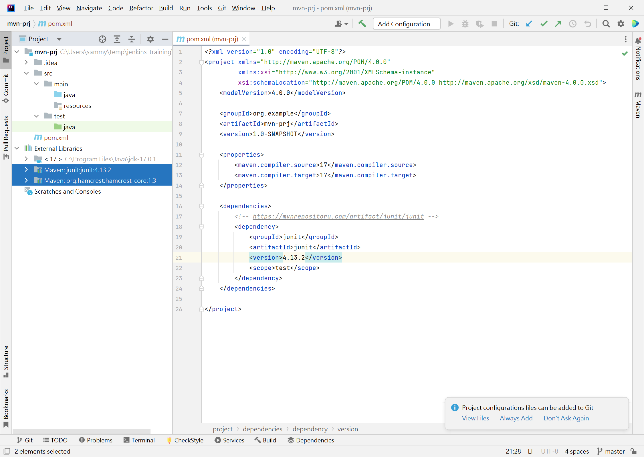
Add JUnit Library

Slide 60
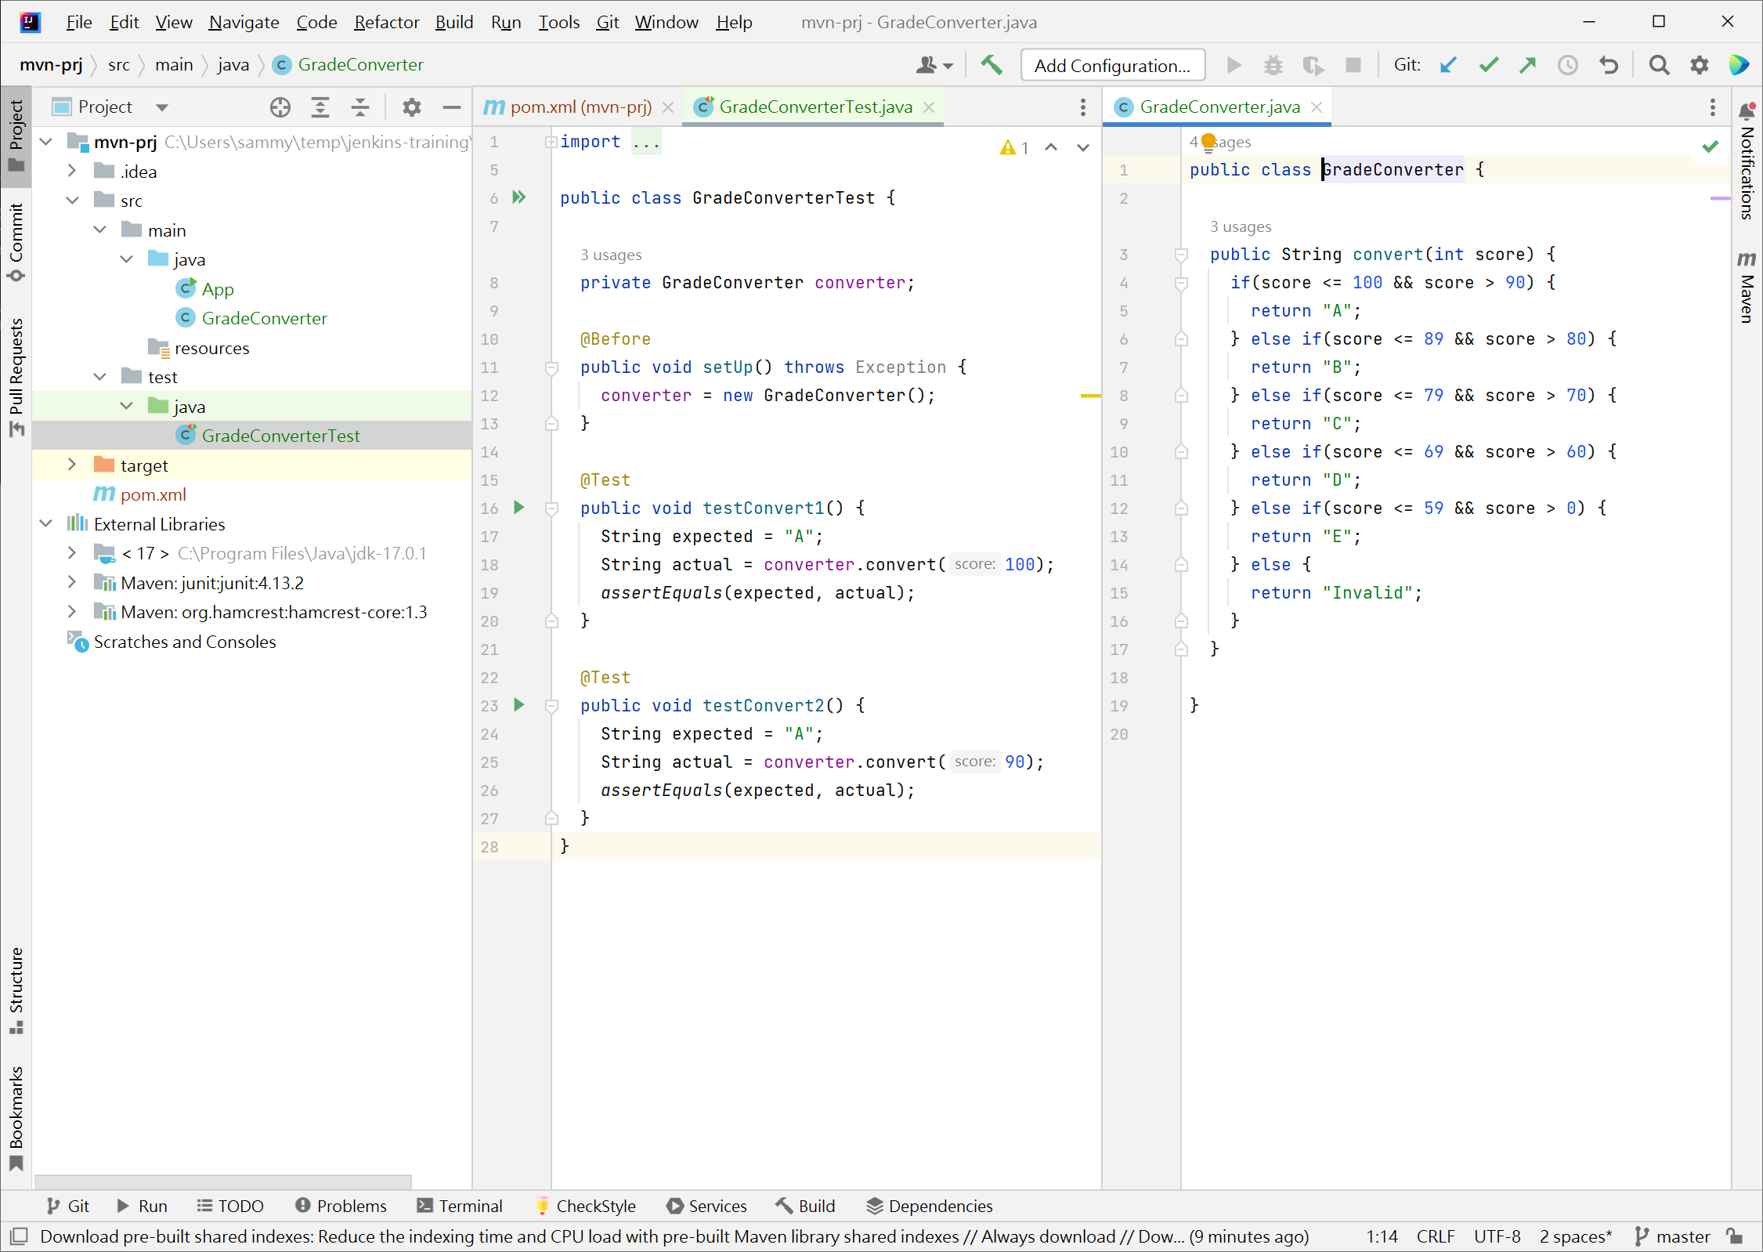
Write Source Code

Slide 61
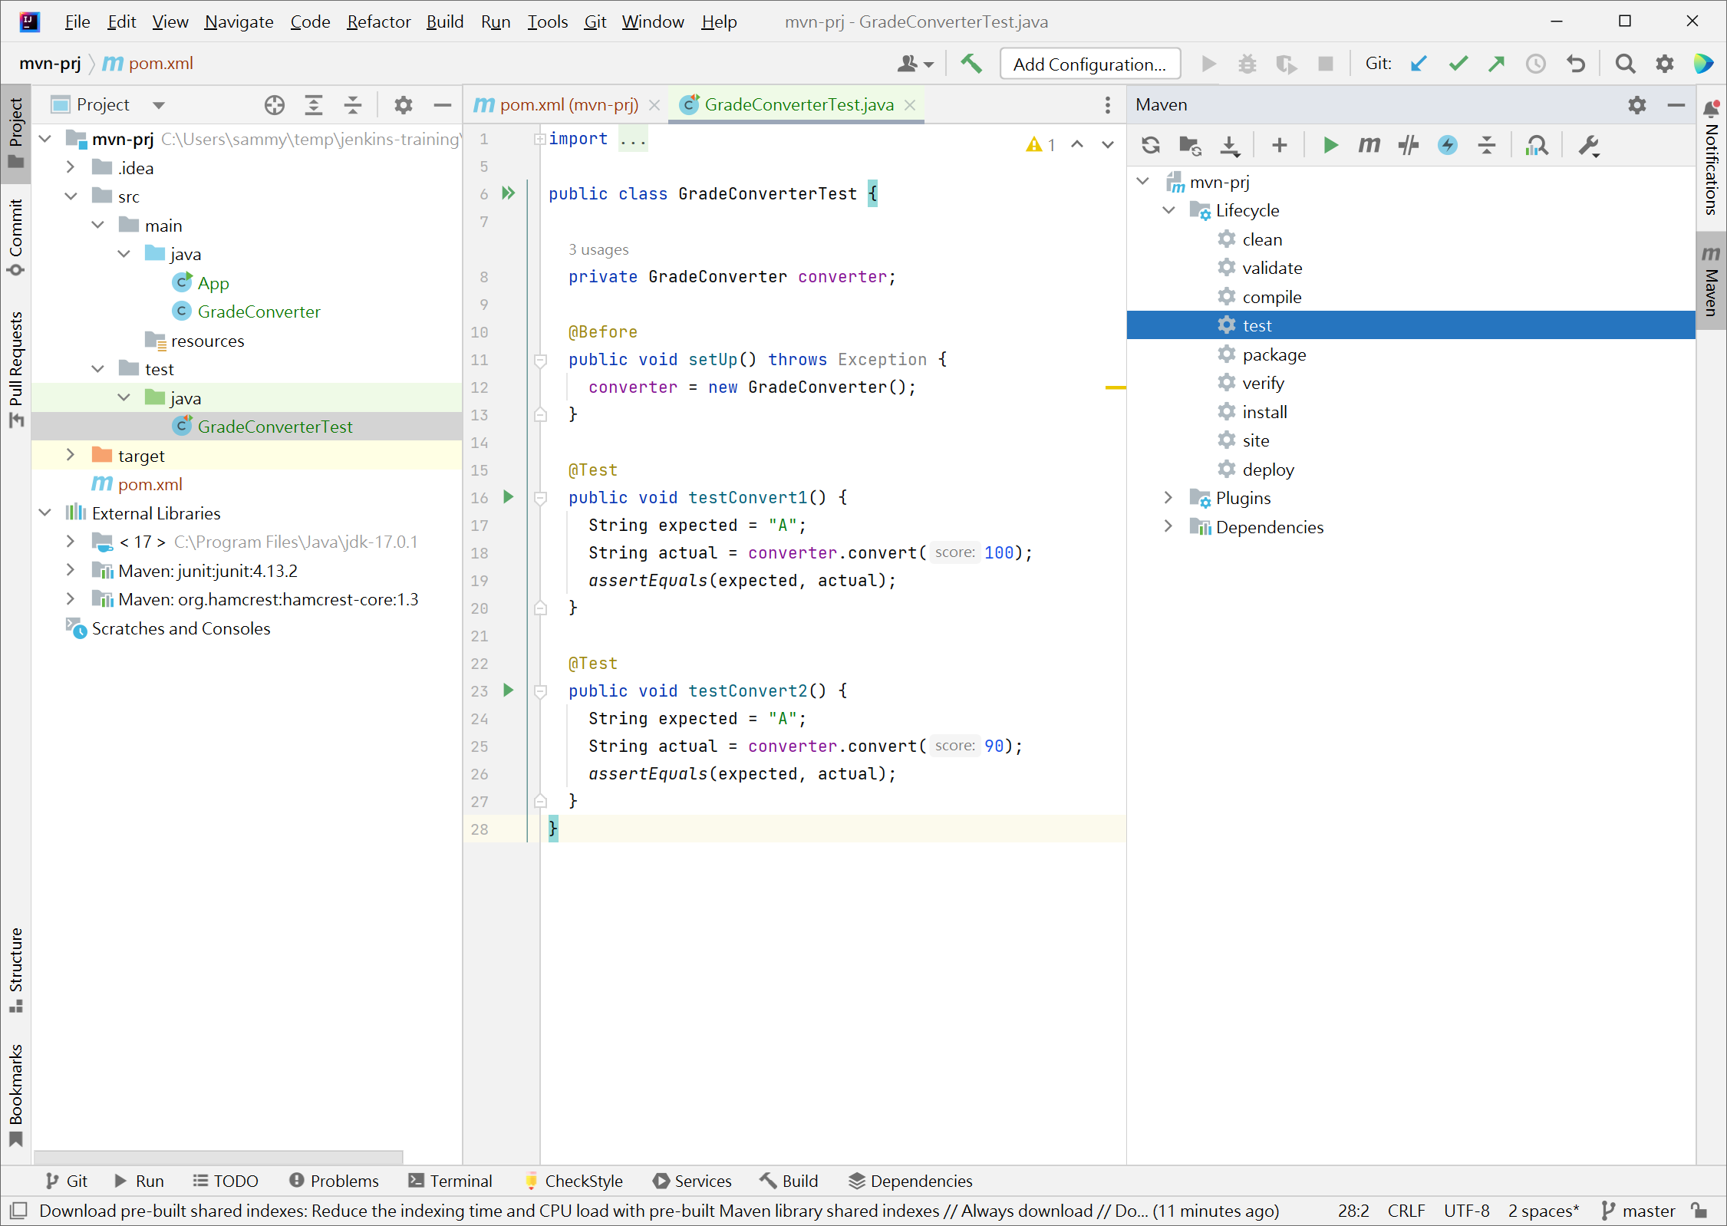
Maven Setting View

Slide 62
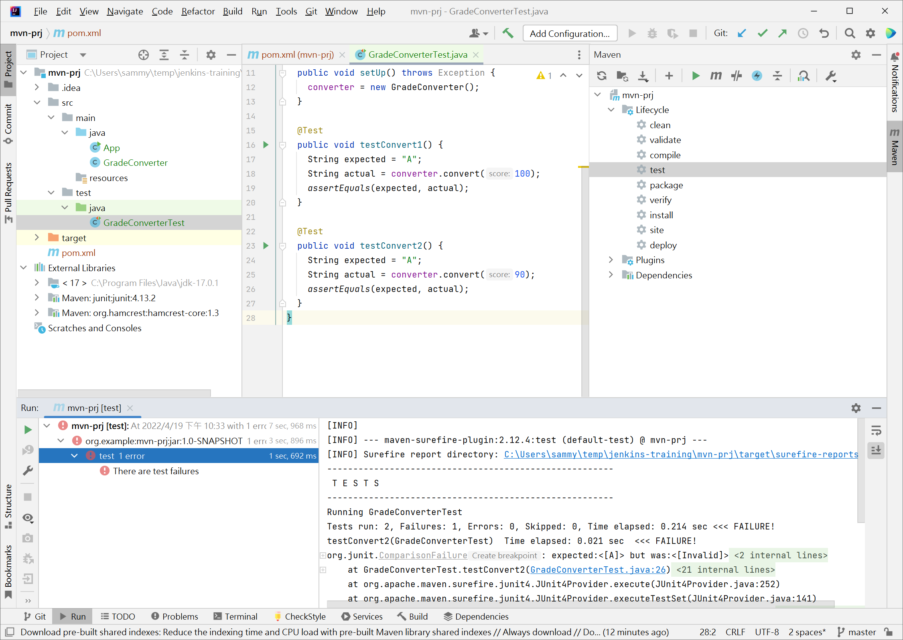
Check Build Result

Slide 63
Version Control Management - Git and GitHub

Slide 64
What is Git
a version control system that is used for software development
a distributed revision control system
aimed at speed, data integrity and and support for distributed, non-linear workflows
created by Linus Torvalds in 2005 for development of the Linux kernel

Slide 65
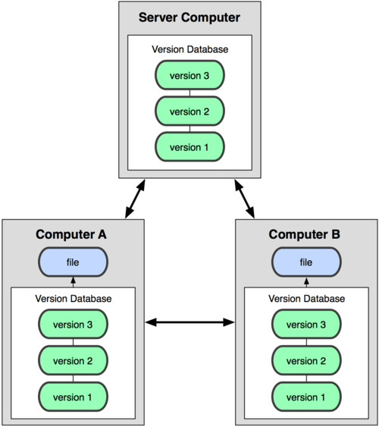
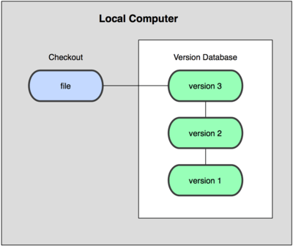
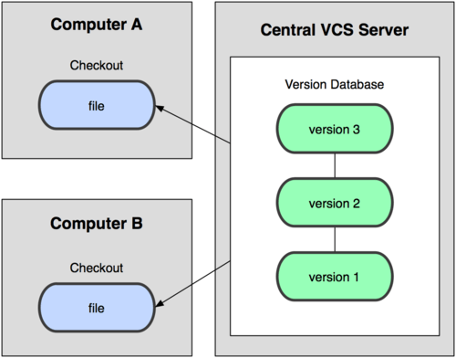
Distributed Version Control

Slide 66
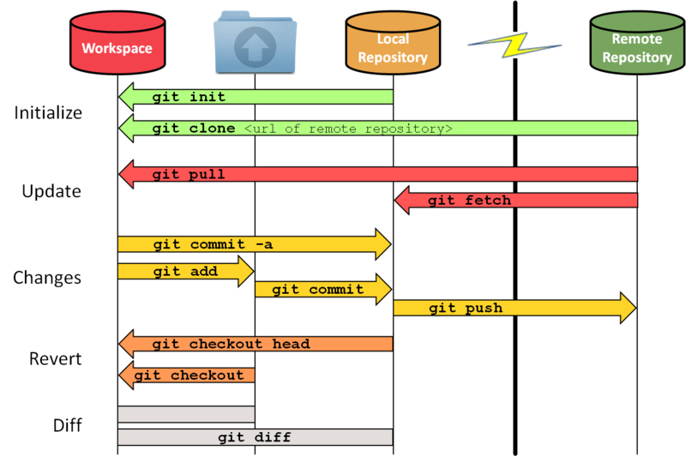
Git Version Control Flow

Slide 67
What is GitHub?
a code hosting platform for version control and collaboration
lets you and others work together on projects from anywhere
GitHub Is Your Resume Now

Slide 68
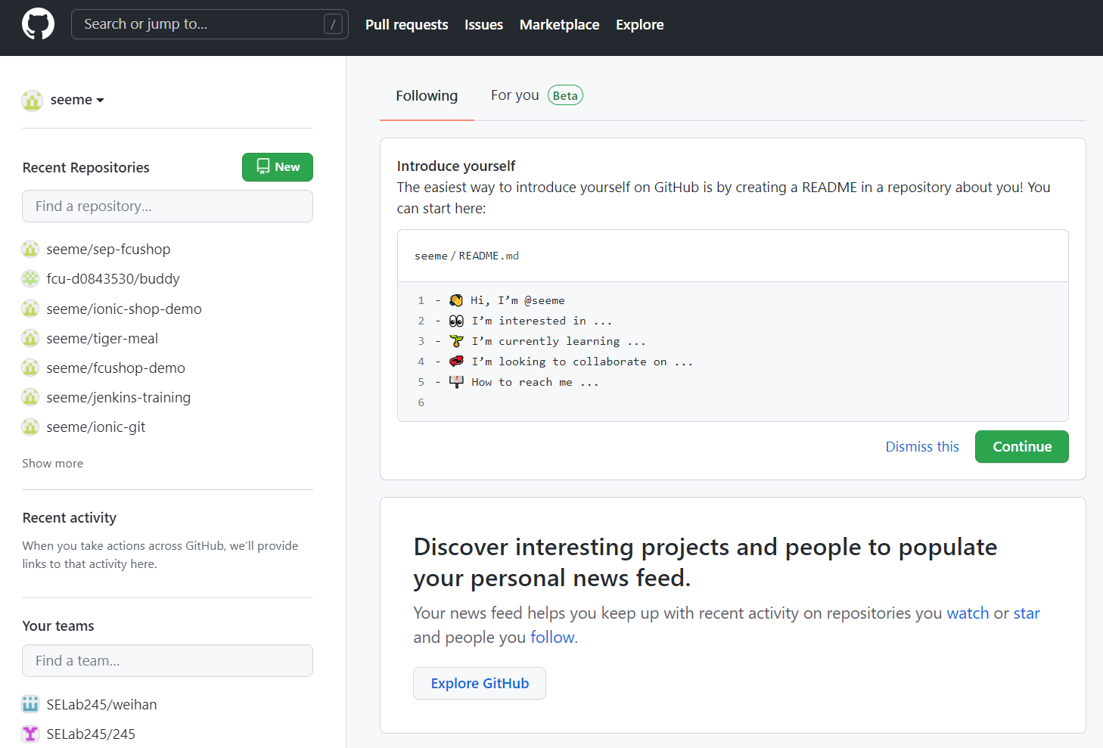
Create GitHub Repository
https://github.com/

Slide 69
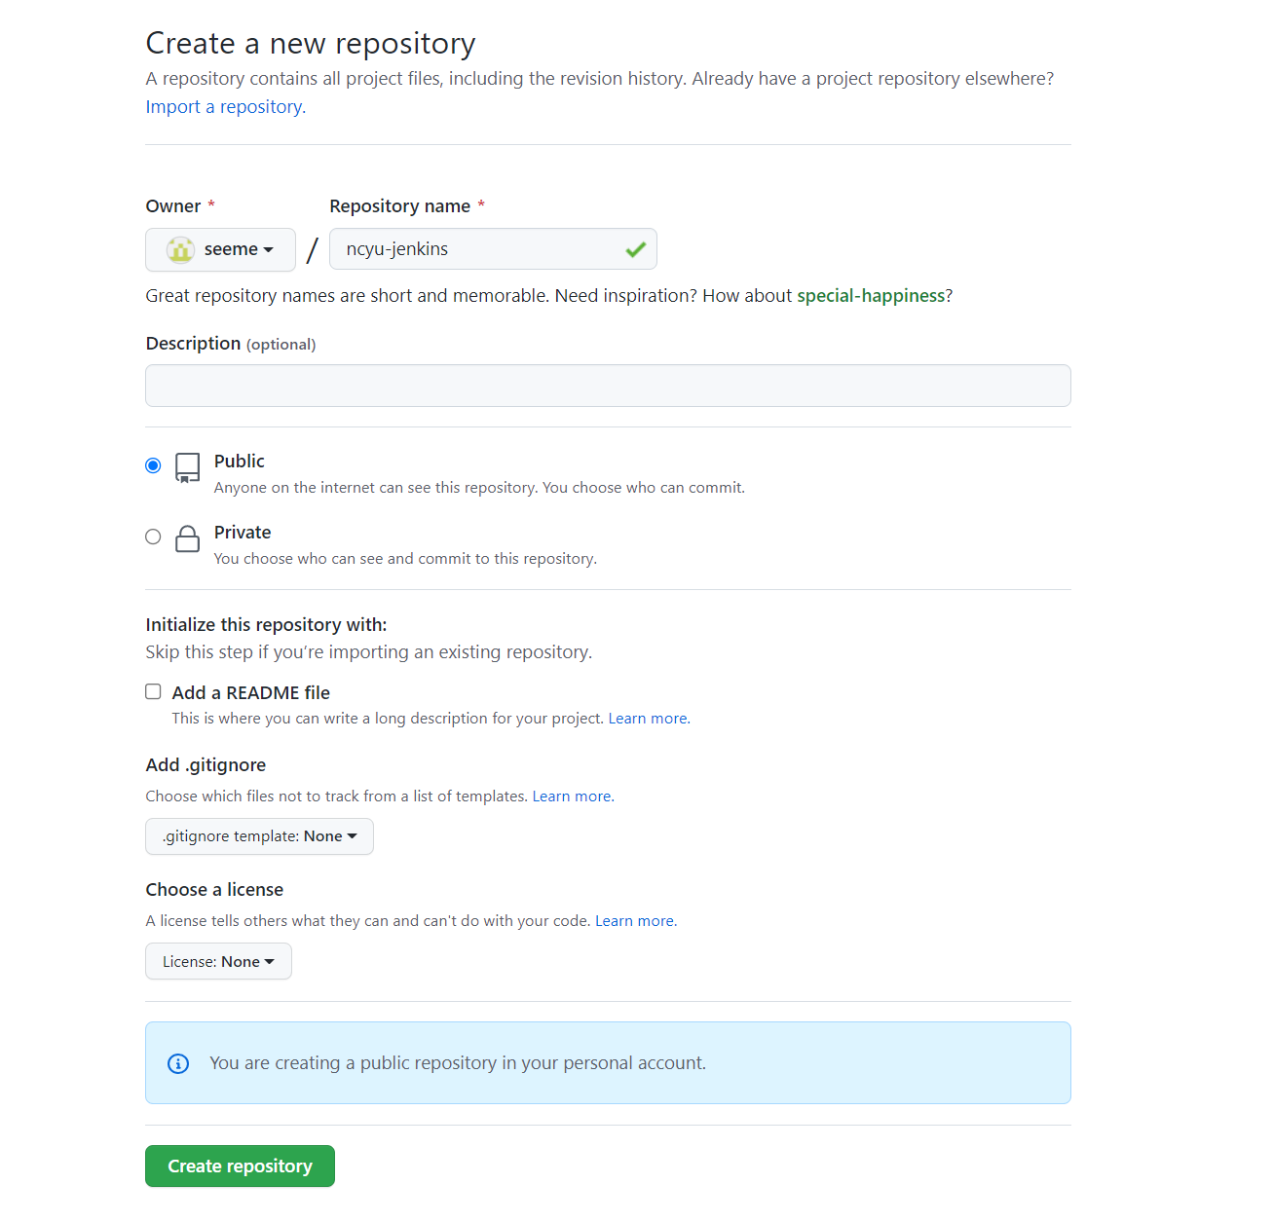
Create GitHub Repository

Slide 70
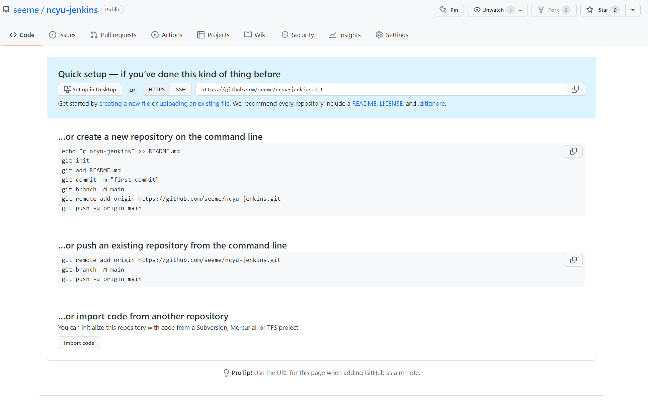
Create GitHub Repository

Slide 71
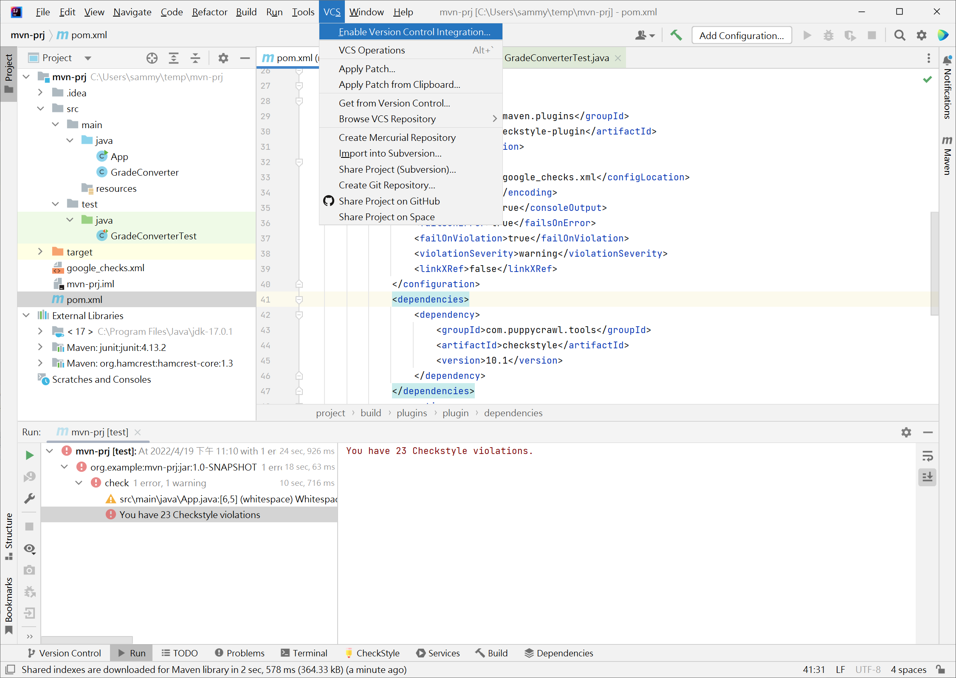
IntelliJ – GitHub Setting

Slide 72
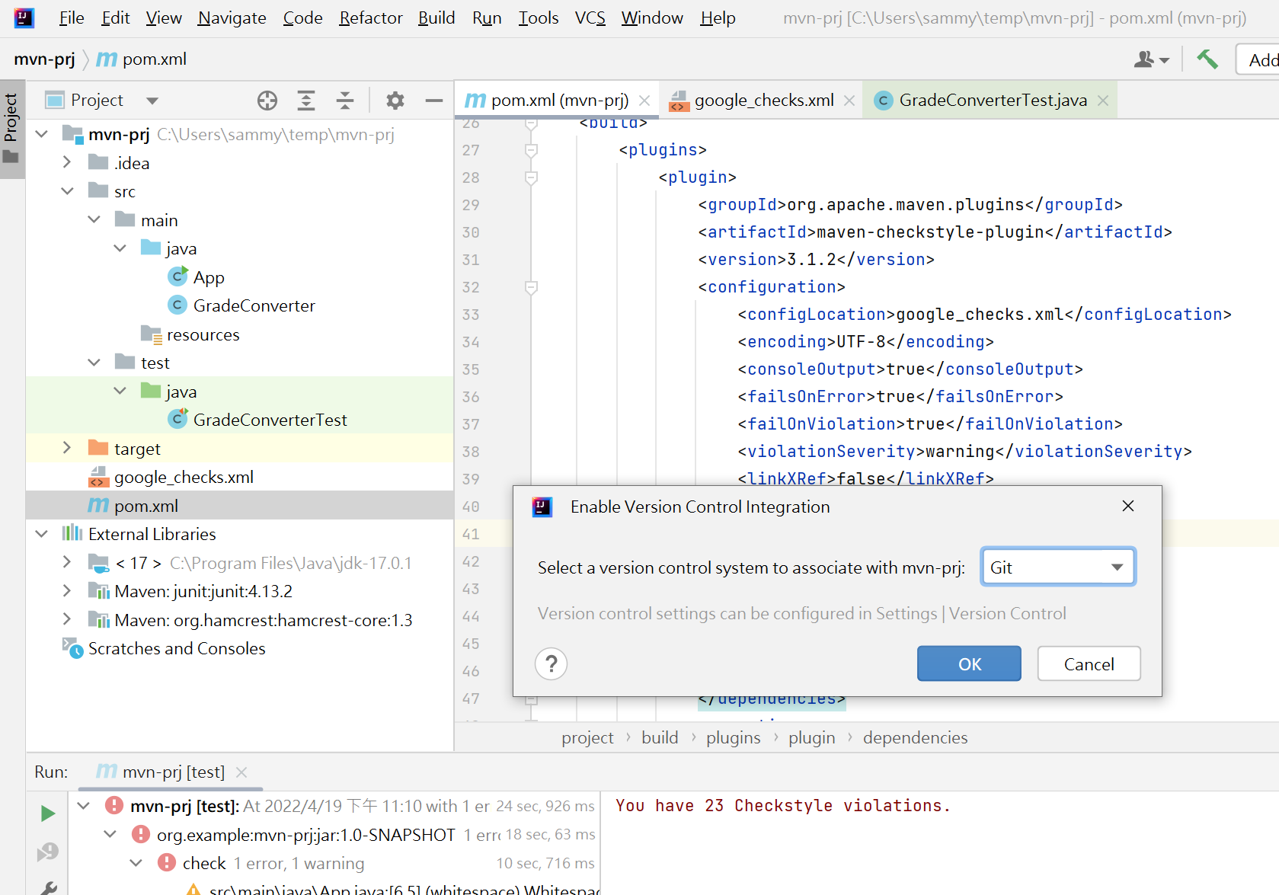
IntelliJ – GitHub Setting

Slide 73
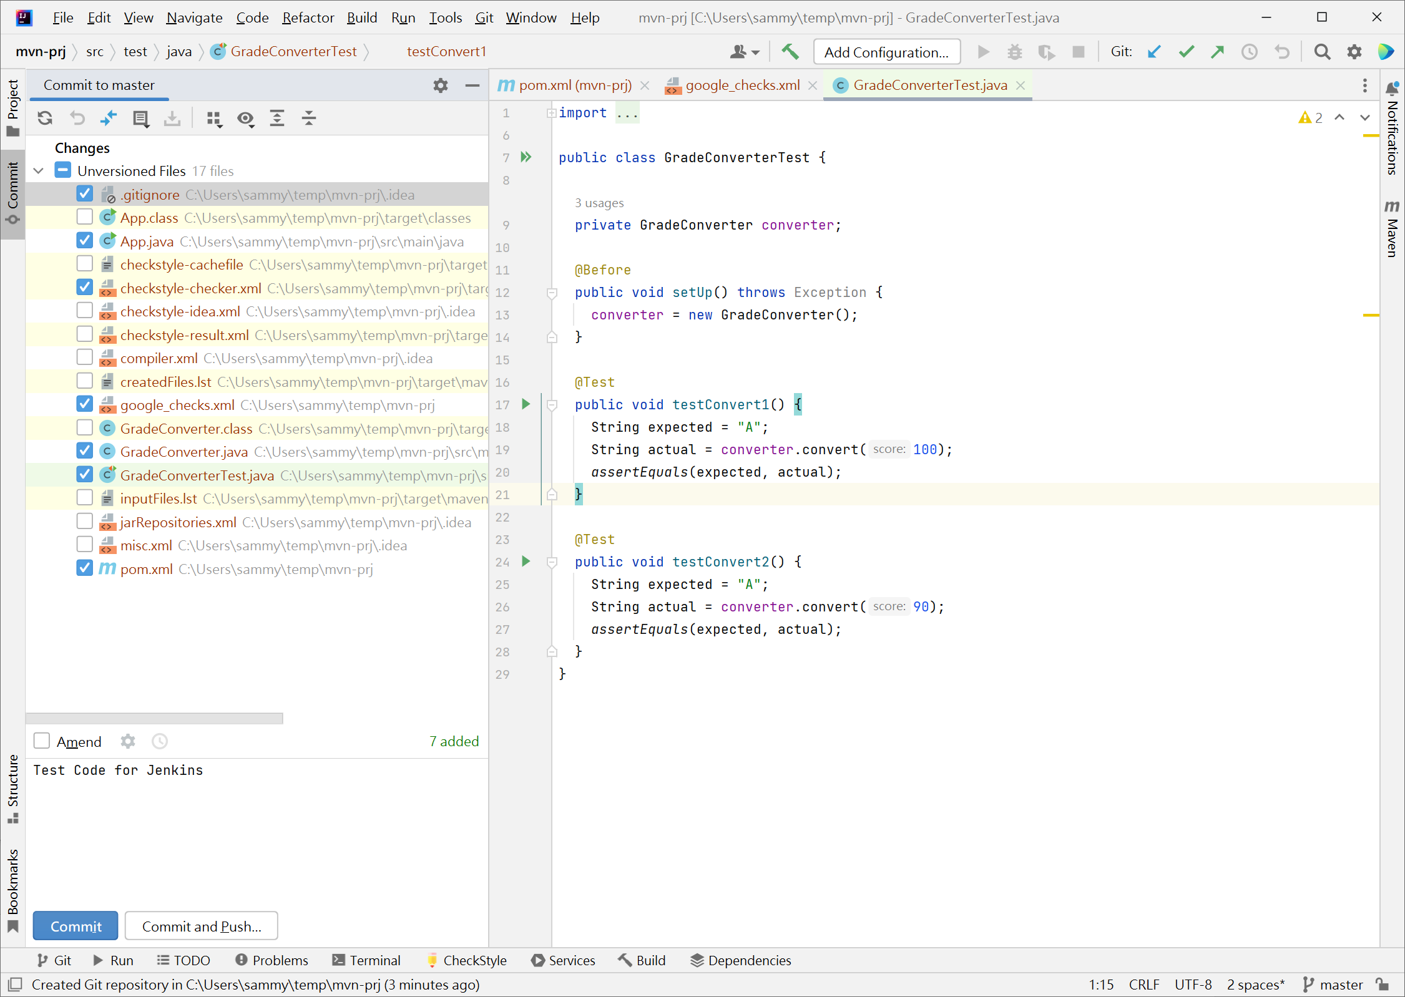
IntelliJ – GitHub Setting

Slide 74
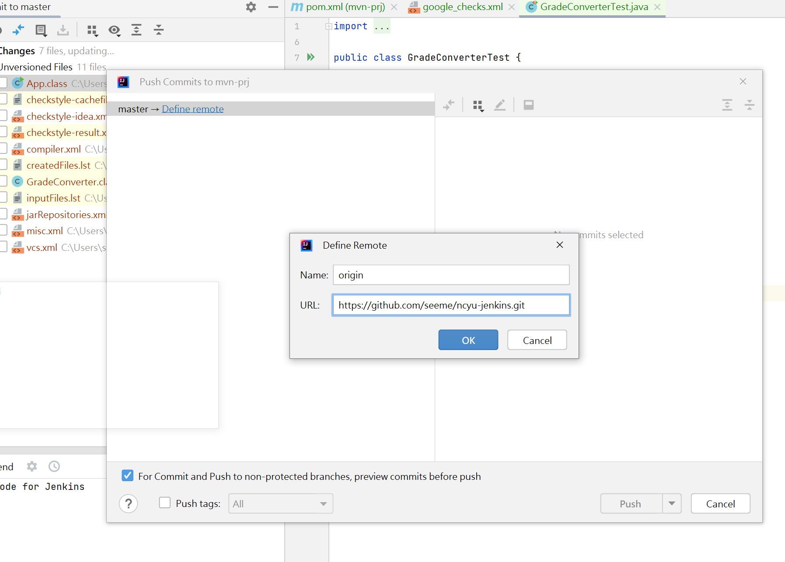
IntelliJ – GitHub Setting

Slide 75
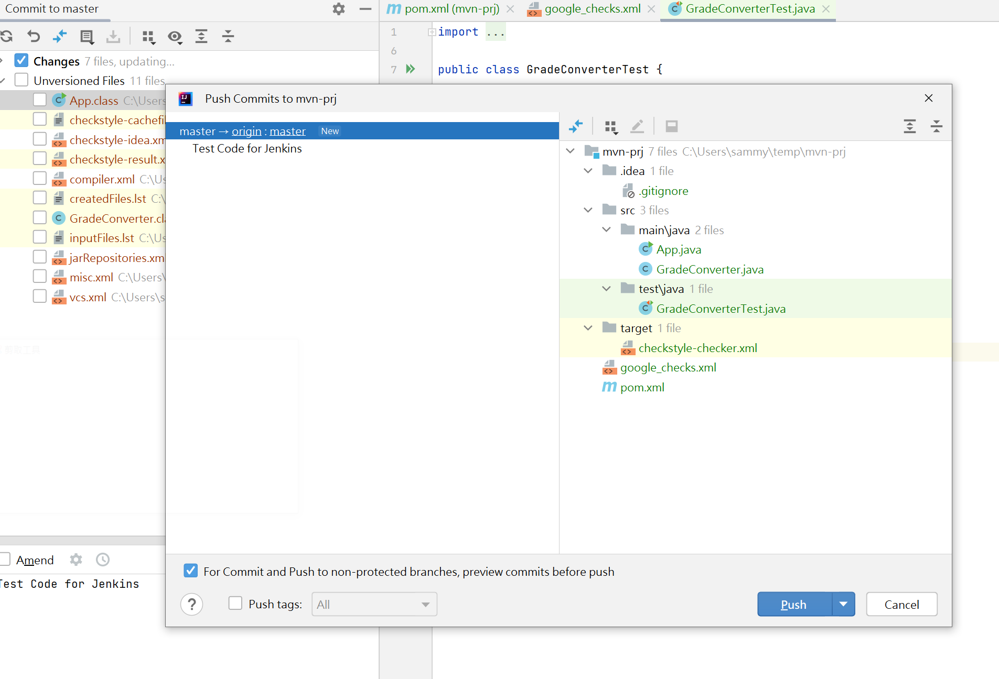
IntelliJ – GitHub Setting

Slide 76
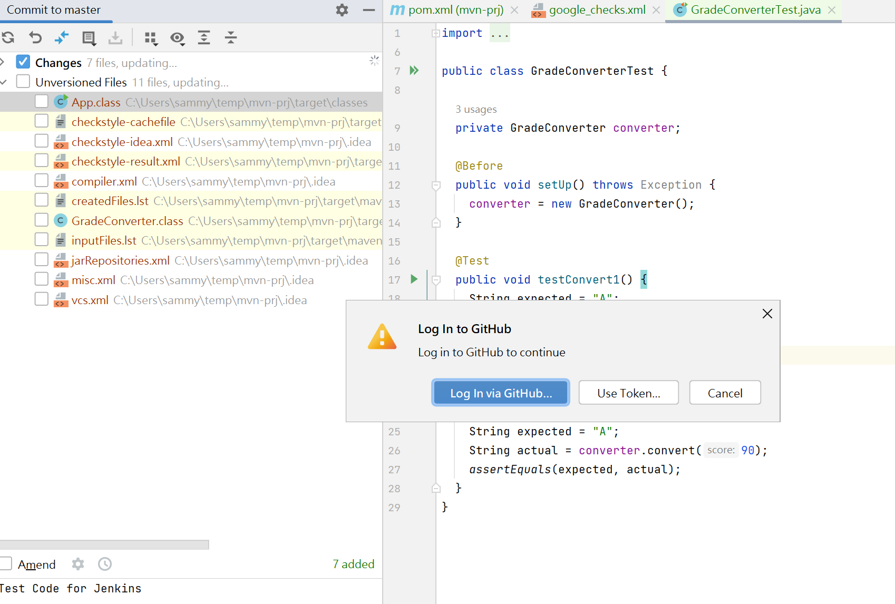
IntelliJ – GitHub Setting

Slide 77

Confirm the push result on GitHub

Slide 78
Continuous Integration - Jenkins

Slide 79
Continuous Integration (CI)
is the practice of merging all developers’ working copies to a shared mainline several times a day
Grady Booch first proposed the term CI in his 1991 method, although he did not advocate integrating several times a day
Extreme programming (XP) adopted the concept of CI and did advocate integrating more than once per day – perhaps as many as tens of times per day

Slide 80
Workflows of CI
Run tests locally
Compile code in CI
Run tests in CI
Deploy an artifact from CI

Slide 81

Continuous Integration: A Typical Process

Slide 82
What is Jenkins?
an open source automation server
helps automate the parts of software development related to building, testing, and deploying, facilitating continuous integration and continuous delivery
supports version control tools, including AccuRev, CVS, Subversion, Git, Mercurial, Perforce, ClearCase and RTC
can execute Apache Ant, Apache Maven and sbt based projects as well as arbitrary shell scripts and Windows batch commands

Slide 83

Download Jenkins
https://www.jenkins.io/download/

Slide 84

Install Jenkins

Slide 85

Install Jenkins

Slide 86

Install Jenkins

Slide 87

Install Jenkins

Slide 88

Install Jenkins

Slide 89

Unlock Jenkins

Slide 90

Unlock Jenkins

Slide 91

Unlock Jenkins
http://localhost:8082

Slide 92

Install Suggested Plugins

Slide 93

Install Suggested Plugins

Slide 94

Create Admin User

Slide 95

Instance Configuration

Slide 96

Jenkins is Ready

Slide 97

Jenkins is Ready

Slide 98

Global Tool Configuration

Slide 99

Global Tool Configuration
Config JDK

Slide 100

Global Tool Configuration
Config Maven

Slide 101

New Item

Slide 102

New Item
Enter an item name and project type

Slide 103

New Item Configuration
Config Source Code Management

Slide 104


New Item Configuration
Config Maven build goal
clean test

Slide 105

Build the project manually

Slide 106

Build task is executing

Slide 107

Checkout console log

Slide 108

Automatic Build with Jenkins
Config Triggers (*/1 * * * *)

Slide 109

Update source code of your project
For example, update README

Slide 110

Source code are built automatically

